Slide 1

Unit 2 Out of this world
Welcome to the unit & Reading (I)
张玉洁 合肥市第四十五中学

Slide 2

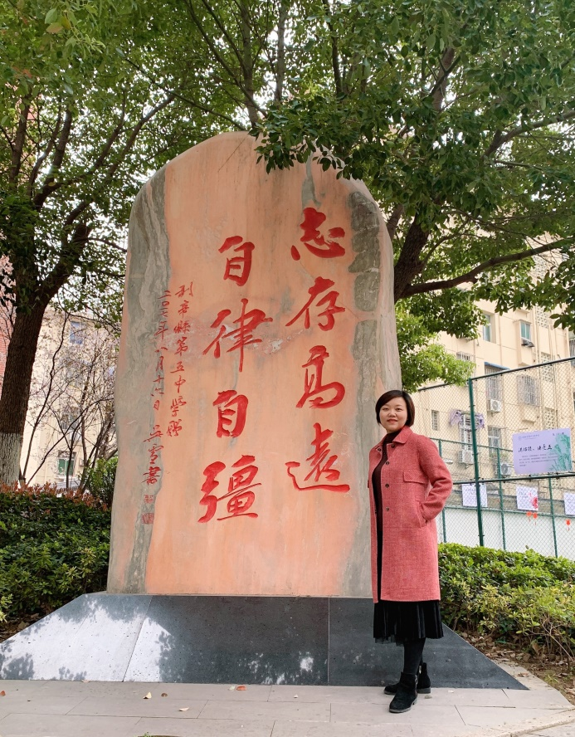
张玉洁
（请老师在此处放一张个人照片，不要选择自拍照。工作场景照最佳，生活照也好。）
庐阳区英语教学能手
庐阳区教学比赛一等奖
多媒体教学比赛一等奖
合肥市优质课比赛二等奖

Slide 3
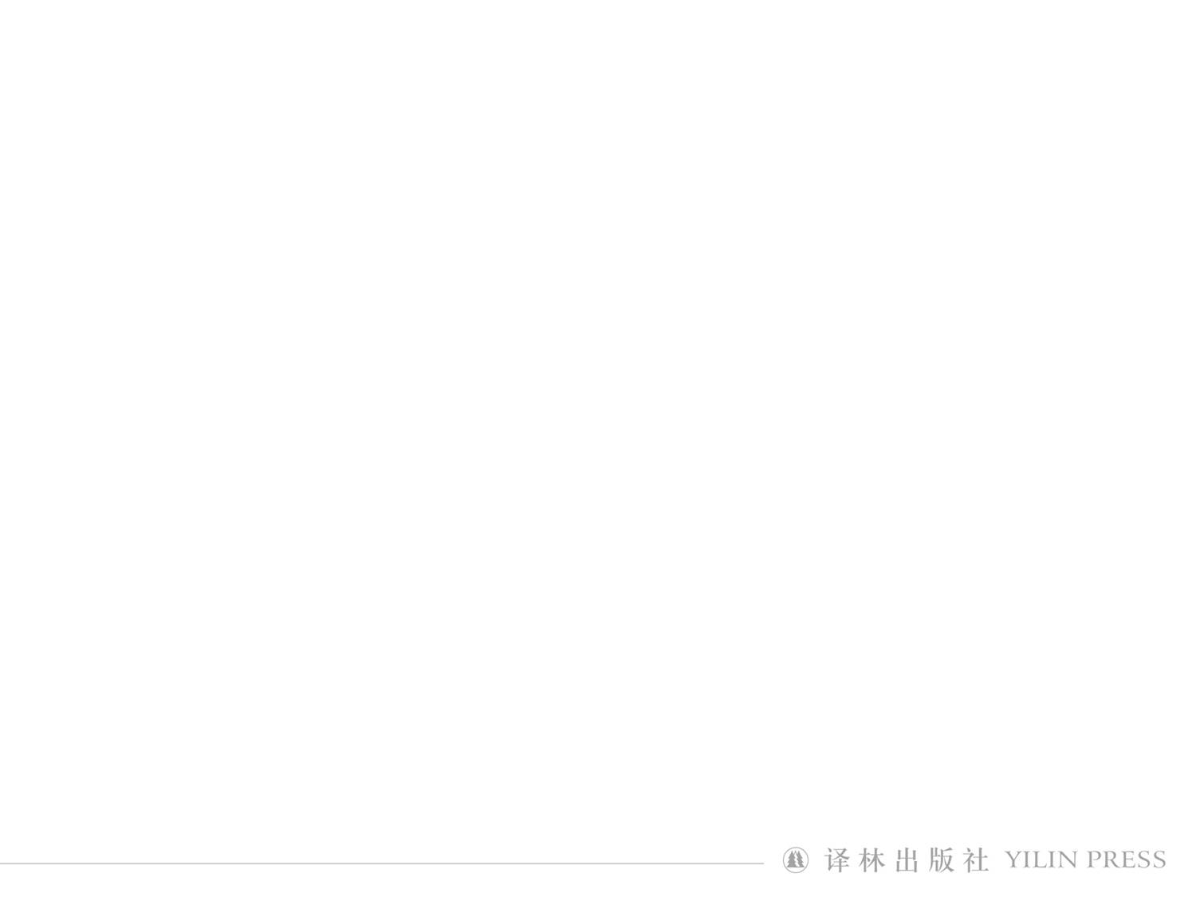

Welcome to the Unit
1961
1969
1971
2000

Slide 4
Welcome to the Unit
1) China’s Tianwen-1 Mars probe, launched successfully on 23 July 2020.
2) Zhurong, landing on the Red Planet on 15 May 2021.
3) The first image of a black hole, released in April 2019.

Slide 5
Welcome to the Unit
Yes
experience weightlessness
fun
No
a very uncomfortable journey
danger

Slide 6
Reading
Tips
sleeping, eating, working, exercising and relaxing
follow the necessary rules and processes
do some exercise, read a book or talk to their families or friends over video chat

Slide 7
Reading
Tips
Yang Liwei
in 2003
Liu Yang
the first Chinese woman

Slide 8
Life on a space station
Sleeping
⁽¹⁾_____
⁽³⁾_____
⁽⁴⁾_____
⁽⁵⁾_____
1. Working
3. Eating
4. Exercise
5. Leisure
Performing tasks inside the space station
⁽²⁾_____
2. Performing tasks outside the space station

Slide 9
Another proper title of the text is “__________”.
A. Up in the sky B. A day in space
C. Hardship and fun D. My dream


Slide 10
Questions 1, 2 & 4 in A2
1. How do astronauts sleep in space?
1. They usually sleep in private quarters or sleeping bags.
2. What routine tasks do astronauts do on the space station?
2. They conduct scientific research and do a lot of maintenance.

Slide 11
Questions 1, 2 & 4 in A2
4. How do astronauts drink water or any other liquids?
4. They drink water or any other liquids out of a bag through a thin tube of plastic.

Slide 12
In the author’s opinion, which is the most dangerous in space?
A. Sleeping. B. Conducting experiments.
C. Space walking. D. Feeding and drinking.


Slide 13
3. Why do astronauts put on their spacesuits?
3. They allow them to breathe in space.
5. Why do astronauts need to spend some time in the gym?
5. The near absence of gravity makes them lose muscle and bone mass and going to the gym helps prevent this.

Slide 14
In the 2nd sentence of Paragraph 4, what does the word “circumstances” refer to?
A. Preparations for a spacewalk.
B. Experiments and equipment.
C. All kinds of activities in space.
D. Performing tasks outside the station.


Slide 15
1. What do you think of daily life on a space station?
challenging
exciting
1
sleep
sleep with no pressure against our back
2
a luxury to eat fresh food
3
spacewalk
the most dangerous work
enjoy the splendid view of the Earth

Slide 16
2. At the end of the lecture, what questions would you like to ask the astronauts?
1
whether common people will be able to visit a “tourist” space station one day
2
if she saw anything unusual out in space
3
if she saw anything unusual out in space
4
how the astronauts take showers, go to the washroom and wash their hands

Slide 17
3. What qualities do you think are needed to become an astronaut?
1
cope with high levels of stress
cope with being away from family and friends for long periods of time
2
respond quickly in such risky circumstances

Slide 18
3. What qualities do you think are needed to become an astronaut?
3
specialize in a certain field
solve difficult problems that arise
4
Being calm under pressure
5
physically strong and healthy

Slide 19
1) It’s strange that we try to sleep with no pressure against our back, but the unusual beds don’t bother us any more.
that we try to sleep with no pressure against our back

Slide 20
2) The routine tasks that occupy most of the day are demanding, but they can also be extremely rewarding.
The routine tasks

Slide 21
3) I’m working on one experiment which locates and tracks lightning over large regions of the earth. Hopefully, it will cast new light on the earth’s climate and lead to better lightning protection.
one experiment

Slide 22
4) First, we put on our spacesuits, which allow us to breathe in space and protect us from exposure to the cold and radiation.
spacesuits

Slide 23
spacewalking
5) Splendid as the view of the earth is, spacewalking is not as exciting as you might think. It’s probably the most dangerous work, with potential risks such as electric shocks. That’s why every spacewalk is carefully planned.
the main content of the preceding text

Slide 24
6) It’s luxury to eat fresh food, because fresh produce such as fruit and vegetables can only be delivered to the space station from the Earth every couple of months.
to eat fresh food

Slide 25
7) Salt and pepper are only in liquid form, so that they will not float off and block the air pipes.
Salt and pepper

Slide 26
What does the “it” refer to in the last sentence of the transcript?
A. Fun in leisure time.
B. All the hardship in space.
C. Exercising every day.
D. Space walking.


Slide 27
Homework
1. Write a summary of the text.
Sample:
Living in space is a challenging but magical adventure. In the surroundings of low gravity, the astronauts must have themselves attached while sleeping to avoid floating around. In space, special experiments are conducted to learn more about changes in cells and microorganisms, and lightening. However, tasks outside the space station are the most challenging and dangerous. Besides, other daily routines up in the sky, like eating & drinking, exercise entertainments, are also different from that on the Earth.

Slide 28
2. Watch the micro lesson: Improve cohesion with pronouns and check yourself
1) “My friends said: ‘Now we believe your stories,’” Welty added. “And I said: ‘Now you know. These are the people that make me write them.’”
The word “them” refers to Welty’s ________.
A. readers B. parties C. friends D. stories


Slide 29
2) Another strategy used at some well-known parks such as Disneyland is for top managers to spend at least one day in their work, touring the park dressed as Mickey Mouse or something like that. This provides them with a perfect chance to examine the scene and watch the customers without being noticed.
A. Visiting Disneyland.
B. Wearing attractive clothes.
C. Acting Mickey Mouse.
D. Dressing up and walking around.


Slide 30
3) Despite the celebrations, though, in the U.S. the jazz audience continues to shrink and grow older, and the music has failed to connect with younger generations.
It’s Jason Moran’s job to help change that. As the Kennedy Center’s artistic adviser for jazz, Moran hopes to widen the audience for jazz, make the music more accessible, and preserve its history and culture.
A. Jazz becoming more accessible.
B. The production of jazz growing faster.
C. Jazz being less popular with the young.
D. The jazz audience becoming larger.


Slide 31

4) These local citizens now have to balance their traditional self-supporting hunting lifestyle with the lifestyle offered by the modern French Republic, which brings with it not only necessary state welfare, but also alcoholism, betrayal and even suicide.
A. The modern French lifestyle.
B. The self-supporting hunting.
C. The uncivilized hunting.
D. The French Republic.


