Slide 1

Unit 2 Out of this world
Reading (II)
张玉洁 合肥市第四十五中学

Slide 2

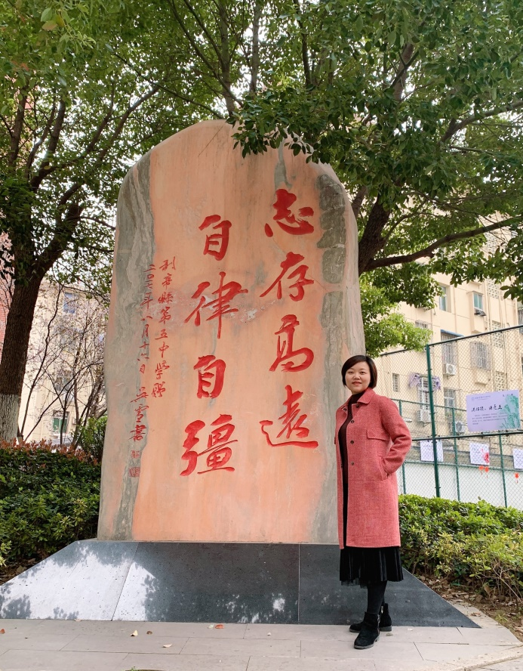
张玉洁
（请老师在此处放一张个人照片，不要选择自拍照。工作场景照最佳，生活照也好。）
庐阳区英语教学能手
庐阳区教学比赛一等奖
多媒体教学比赛一等奖
合肥市优质课比赛二等奖

Slide 3
Verbs | Nouns | Adjectives | Adverbs
 | adventure
differ
 |  |  | definitely
 |  | rewarding
 |  | remarkable
adventure
adventurous
adventurously
difference
different
differently
define
definition
definite
reward
reward
rewardingly
remark
remark
remarkably

Slide 4
Fill in the blanks with proper forms of the above words.
1. Health education wisdom in the UK ________ from that of the United States.
1. differs
2. For the more ________ tourists, there are trips into the mountains with a local guide.
2. adventurous
3. Generally speaking, giving is much ________ than receiving in the long term.
3. more rewarding

Slide 5
Fill in the blanks with proper forms of the above words.
4. ________ of all words in this dictionary are printed in roman type.
4. Definitions
5. He concluded from their ________ that they were not in favour of the plan
5. remarks

Slide 6
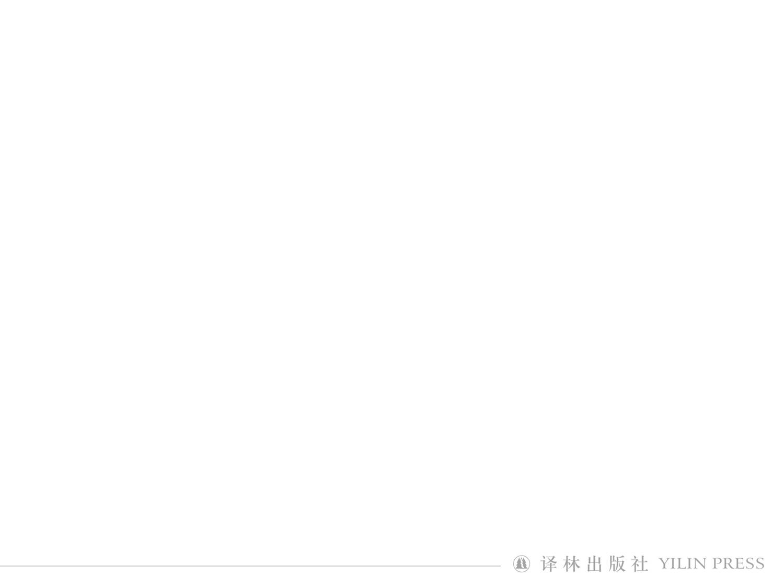
1. absence
Definitions
absence: being away
absentee: person who isn’t present
Vocabulary web
absence n.

absent adj.

absently adv.

absentee n.
absent-minded adj.

absent-mindedly adv.

absent-mindedness n.

Slide 7
2. occupy
Definitions
occupy: 1) live in or have possession of 2) take up or fill 3) hold or fill (an official position)
occupied adj.: in use; filled
occupation n.: 1) action of occupying or state of being occupied 2) job or employment
Vocabulary web


occupation n.
occupy v.
occupied adj.
occupy oneself (in doing sth./with sth.)
be occupied in doing sth. (with sth. )

Slide 8
3. evaluate
Definitions
evaluate v. : find out or form an idea of the amount or value of (sb./sth.); assess
invaluable adj.: extremely valuable
valueless adj.: having no value, worthless
Vocabulary web
value v.

evaluate
evaluation n.

value v.

valuable adj.

invaluable adj.

valueless adj.

Slide 9
4. maintenance
Definitions
1) maintaining or being maintained
2) money that one is legally required to pay to support sb.
Vocabulary web
maintain v.

maintenance n.

Slide 10
5. exposure n.
Definitions
1) action of exposing or state of being exposed
2) instance of exposing or being exposed
3) action of exposing a film etc. to the light
Vocabulary web
expose v.

exposed adj.

exposure n.
ex-
exit n.；
exist v.；
expose v.；
explode v. ；
export v. ;
explore v.;
expand v.

Slide 11
6. visible adj.
Definition
that can be seen; in sight
Vocabulary web
visible adj.


visibly adv.
visibility n.
visible adj.

invisible adj.

invisibly adv.

invisibility n.

Slide 12
Fill in the blanks with proper forms of the given words.
1. They took in poor-graded students and graduated them on lower marks, so the degree became ________ (value).
1. valueless
2. The weather was at its worst with heavy fog that gave minimum ________ (visible).
2. visibility

Slide 13
Fill in the blanks with proper forms of the given words.
3. The most important thing to be happy for the old is to keep them ________ (occupy).
3. occupied
4. Only by keeping down costs will America ________ (maintenance) its competitive advantage over other countries
4. maintain

Slide 14
Fill in the blanks with proper forms of the given words.
5. His ________ (absent-minded) during the experimenting nearly caused an explosion of the chemical.
5. absent-mindedness
6. We need to have a proper ________ (evaluate) of the new system before it is carried out.
6. evaluation

Slide 15
Fill in the blanks with proper forms of the given words.
7. Strangely enough, patterns that are ________ (visible) on the ground can be the most striking part of an aerial photograph.
7. invisible
8. Prii became fluent in German during the Wehrmacht’s ________ (occupy) of Estonia in 1942.
8. occupation

Slide 16
Fill in the blanks with proper forms of the given words.
9. He stared ________ (absent) into the darkness outside the train window, a glowing cigarette between his fingers.
9. absently
10. We are ________ (exposure) to an overwhelming number of chemical contaminants every day in our air, water and food.
10. exposed

Slide 17
Finish exercise B1P19 within five minutes.
1. missions
2. evaluate
3. of vital importance
4. cast new light on
5. visible
6. circumstances
7. absence
8. bothers

Slide 18
Understand the complex sentences
1. It’s strange that we try to sleep with no pressure against our back, but the unusual beds don’t bother us any more. (Para. 2)
1. This sentence includes two compound sentences connected by “but”. In the first compound sentence, “it” is the preparatory subject and “that” leads to the actual subject clause. Besides, there’s a “with + compound object”: with no pressure against our back.

Slide 19
Understand the complex sentences
2. With so much going on, the space station needs a lot of maintenance, so we constantly check support systems and do some cleaning. (Para. 3)
2. This sentence includes two compound sentences connected by “so”, expressing “cause and effect”. In the first compound sentence, there is a “with + compound object”: With so much going on.

Slide 20
Understand the complex sentences
3. Splendid as the view of the Earth is, spacewalking is not as exciting as you might think. (Para. 4)
3. The main body of the sentence is “spacewalking is not as exciting”. The first “as” conducts a concessive adverbial clause with “splendid” inverted. The third “as” conducts an adverbial clause.

Slide 21
Understand the complex sentences
4. Considering these negative effects low gravity has on the human body, we discipline ourselves to do at least two hours of exercise every day. (Para. 6)
4. The main body of the sentence is “…we discipline ourselves to do…exercise”. “Considering” conducts an adverbial clause.

Slide 22
Understand the complex sentences
5. During our leisure time, there’s nothing we like more than to sit back with the rest of the crew and watch our remarkable planet go by, taking pictures for our family and friends back home. (Para. 7)
5. The main body of the sentence is “…there’s nothing…”. The part “to sit back…and watch…” is the infinitives as attribute modifying “nothing”. The part “taking picture…” is present participle as adverbial modifying verbs “sit” and “watch”.

Slide 23
Homework
1. Watch the micro lesson: Word formation (Optional)
2. Revise the core vocabulary and the complex sentences after class.

Slide 24

4) These local citizens now have to balance their traditional self-supporting hunting lifestyle with the lifestyle offered by the modern French Republic, which brings with it not only necessary state welfare, but also alcoholism, betrayal and even suicide.
A. The modern French lifestyle.
B. The self-supporting hunting.
C. The uncivilized hunting.
D. The French Republic.


