Slide 1

Unit 2 Out of this world
Grammar and usage
赵 明 巢湖一中

Slide 2

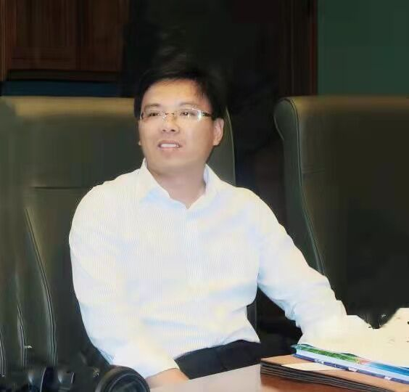
赵 明
合肥市教育名师中学英语工作室主持人
合肥市中学外语教学专业委员会副理事长
合肥市高中英语骨干教师
合肥市高中英语学科带头人
合肥市市属学校教学能手

Slide 3
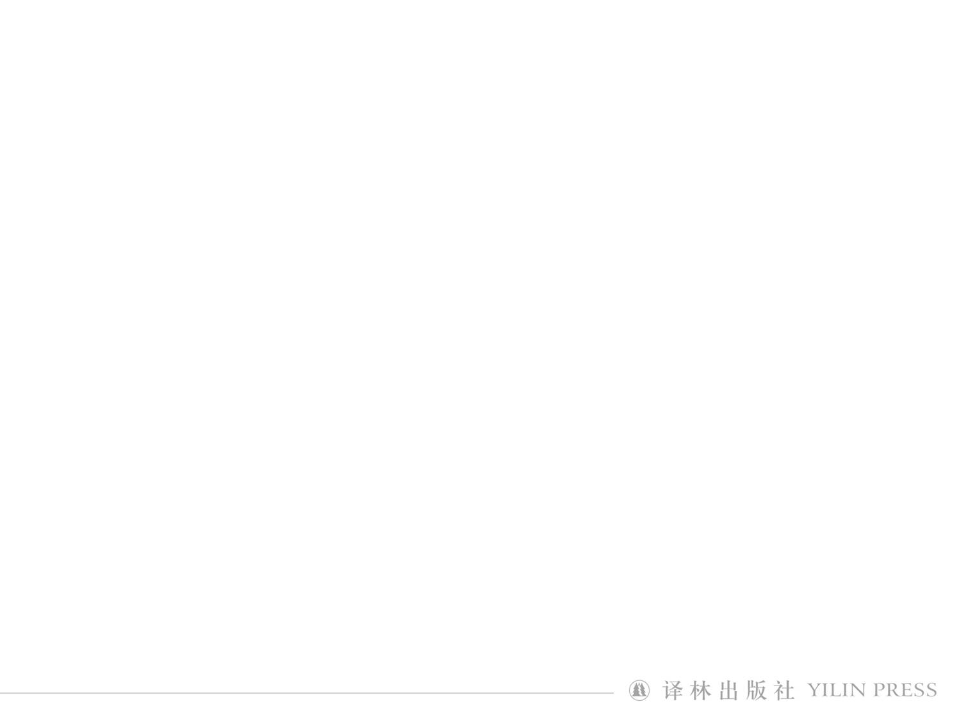
nouns, pronouns, numerals, infinitives, gerunds, etc.
1. The universe is entirely made up of different kinds of matter.
______________
2. To see is to believe.
_______
3. Driving a car to Beijing took longer than I expected.
__________________________

Slide 4
1. That Hubble is based in space allows it to see further than ground-based telescopes, and it allows scientists to learn more about the universe.
__________________________________
2. Whether life on other planets does exist is yet to be proved, but the signs are promising.
_____________________________________________

Slide 5
It is used as the formal subject
The conjunction“that”guides the actual subject clause
It is clear that telescopes are crucial tools for space exploration and that developing the required technology will help astronomers all over the world make exciting discoveries.
_
______________________________________________
_______________________________________________________________
_______________________________________________________________
_____________
How much we will learn from the telescopes is merely limited by our imagination.
__________________________________________________

Slide 6
• We can use a noun clause as the subject of a sentence.
• We can use ⁽¹⁾________ to introduce a subject clause when the clause is a statement. We can use ⁽²⁾________ to introduce a subject clause when the clause is a yes-no question. We can use a question word to introduce a subject clause when the clause is a wh-question.
• We often use ⁽³⁾________ as a preparatory subject when a subject clause is very long.
that
whether
it

Slide 7
Fill in the blanks with proper words (given)
1) ________ well the policy is working is going to be evaluated by some experts.
1) How
2) ________ is known to us all that the astronomer will come to our school.
2) It

Slide 8
Fill in the blanks with proper words (given)
3) ________ mosquitoes need most is blood from man and animals.
3) What
4) It still puzzles us ________ the astronaut didn’t accept the mission.
4) why/that

Slide 9
Fill in the blanks with proper words (given)
5) It is mysterious to scientists ________ the strange creature comes from.
5) where
6) So far, how the accident happened and who are to blame ________ (expose) by the mass media.
6) have been exposed

Slide 10
Fill in the blanks with proper words (given)
7) It was beyond the wildest imagination ________ they met in the circumstances.
7) that
8) It is unknown ________ he always bothers me with this kind of rubbish.
8) why

Slide 11
Fill in the blanks with proper words (given)
9) ________ she can have a day off depends on the administration.
9) Whether
10) It is still a problem facing us ________ we can find the financial aid to build the telescope.
10) where/how

Slide 12
B1 Each sentence below has a mistake. Circle the mistakes and correct them in the blanks.
1
The space mission

That the space mission
2
depend

depends
3
was

is
will

will
4
What

that
5
Tbat

What

Slide 13
B2 Complete the passage with the correct subject clauses in the box below.
1 e
2 b
3 a
4 c

Slide 14
Homework
1. To revise the usage of subject clauses, watch the micro video: Subject clauses (Optional)

Slide 15
Homework
2. Finish off writing B3.
Sample answer:
It is clear that many exciting things will happen in the development of space exploration in the future. I think manned space missions to Mars will happen in my lifetime and a permanent base on Mars will also be established. Hopefully, new energy sources will be developed, which will make space flight cheaper and faster.
But how soon and how far we advance in developing the required technology to do so depends on the collaboration between the many countries around the world. It is possible that the technology will be available before 2040 and I am looking forward to that.

Slide 16

4) These local citizens now have to balance their traditional self-supporting hunting lifestyle with the lifestyle offered by the modern French Republic, which brings with it not only necessary state welfare, but also alcoholism, betrayal and even suicide.
A. The modern French lifestyle.
B. The self-supporting hunting.
C. The uncivilized hunting.
D. The French Republic.


