Slide 1

Unit 2 The universal language
Project
费佳璐 江苏省通州高级中学

Slide 2

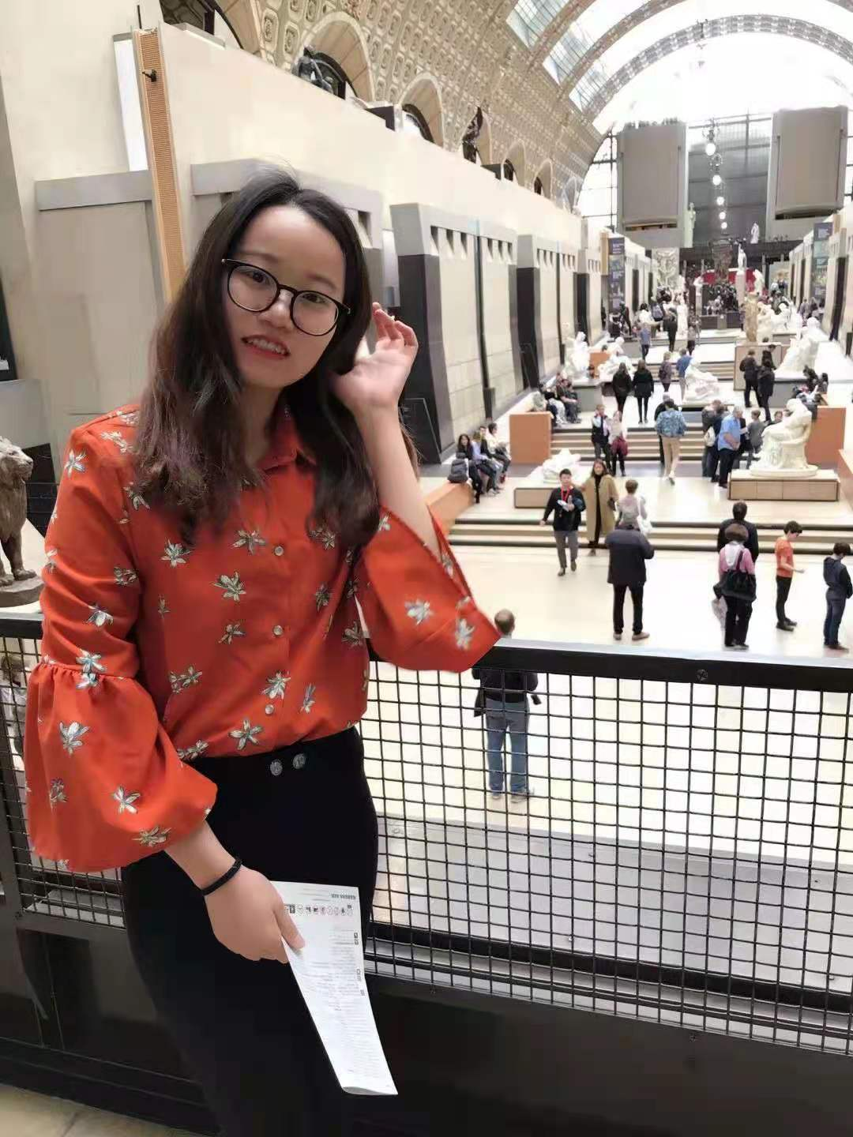
费佳璐
中学二级教师

Slide 3
Step
1
Introduction
What is a profile?
a description of sb/sth that gives useful information
the general impression that sb/sth gives to the public and the amount of attention they receive
the edge or outline of sth that you see against a background

Slide 4

Step
2
Free talk
Which English song do you like best?

Slide 5
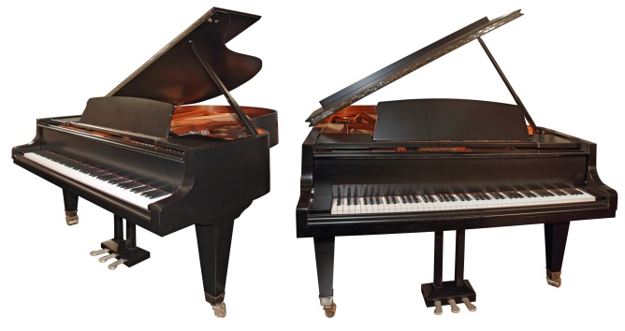
Step
2
Free talk
Choose a song to research
in your group!

Slide 6
Step
2
Free talk
Discussion in group
Which song would your group like to research?
Why do you choose this song?
How to research a song?

Slide 7
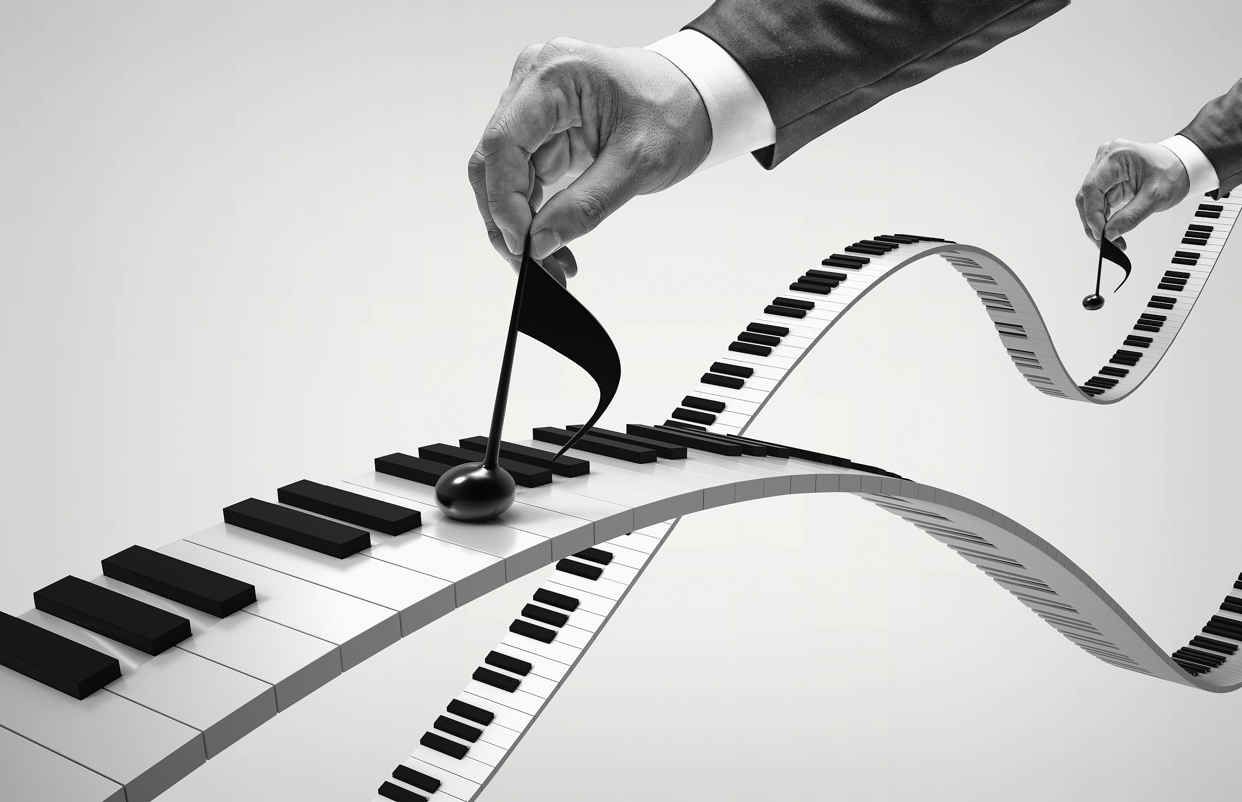
Step
3
Preparing
What should you consider when you research a song?
Singer/Band
Background
Lyrics
Style
Meaning
...
Song

Slide 8
Step
Preparing
3
Example
“Take Me Home, Country Roads”
Singer/Band | Background | Lyrics | Style | Meaning
John Denver | Based on West Virginia, John Denver wrote this song in memory of his golden days in his hometown. | ... Country roads, take me home To the place I belong West Virginia Mountain Mama Take me home, country roads ... | Country music | Loving nature, missing his hometown and his family

Slide 9

Step
3
Preparing
Notice
When searching for information from different resources, remember to:
Check the the accuracy of the information, especially on the Internet.
Check the meaning and background of a song to show the popularity of the song.
Information from official sources can be trusted.

Slide 10
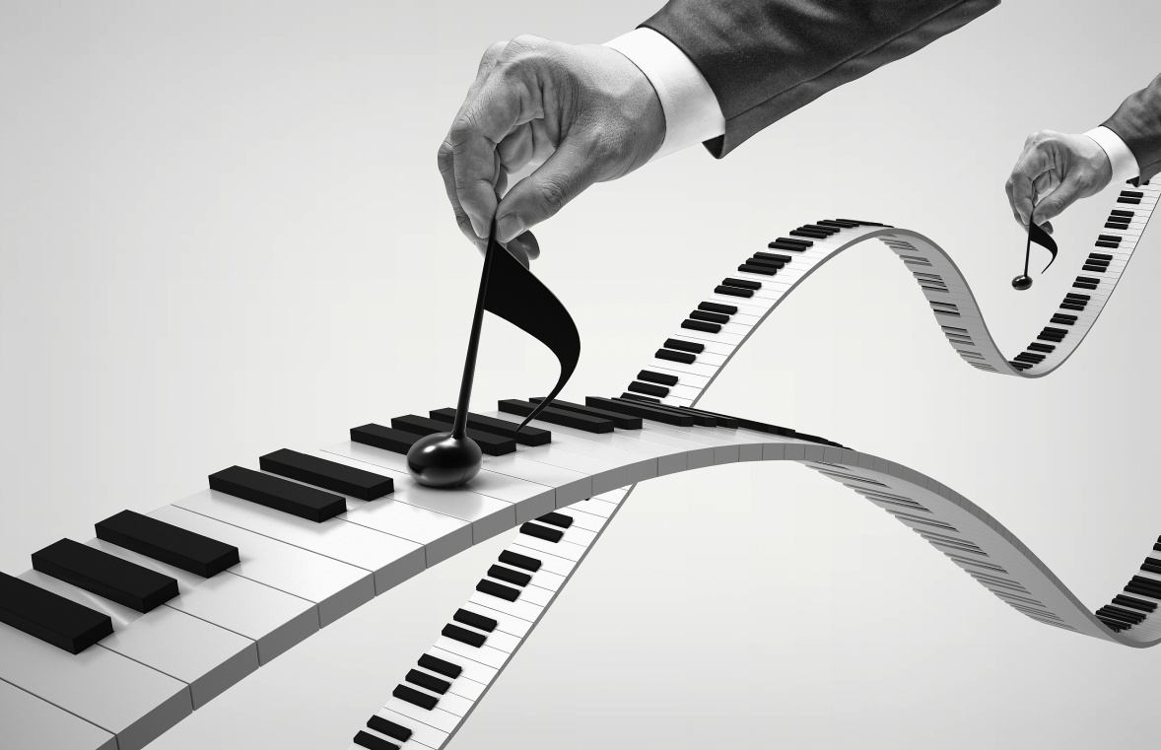
Step
4
Put the pieces together
Put together the information to make you profile.
Use the example in the textbook to help you.

Slide 11
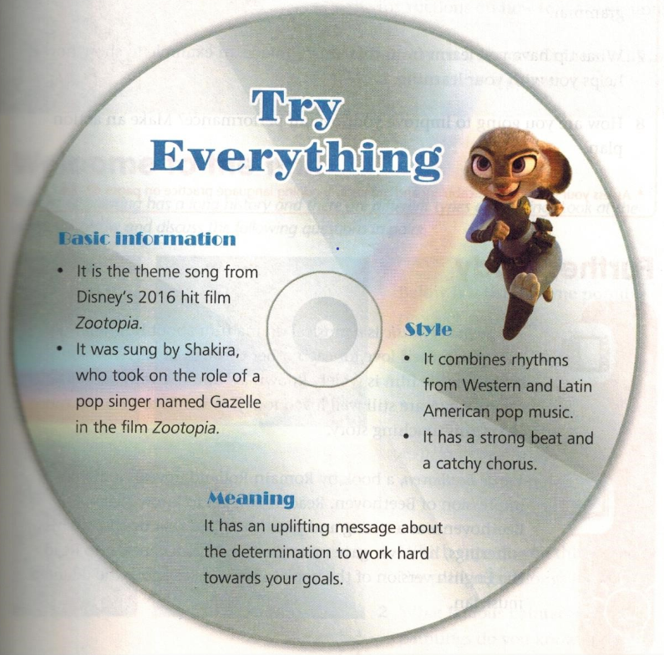
background
singer
You can add lyrics

Slide 12
Step
4
Put the pieces together
How to make a profile?
Get information prepared.
Organize materials and ideas.
Fill your materials in the profile.
Decorate your pages with interesting illustrations.

Slide 13
Step
5
Presentation
Share with classmates

Slide 14
Step
6
Evaluation
vote on the best one
make comments
give reasons

Slide 15
Homework
Polish up your profile based on the assessment.

Slide 16


