Slide 1
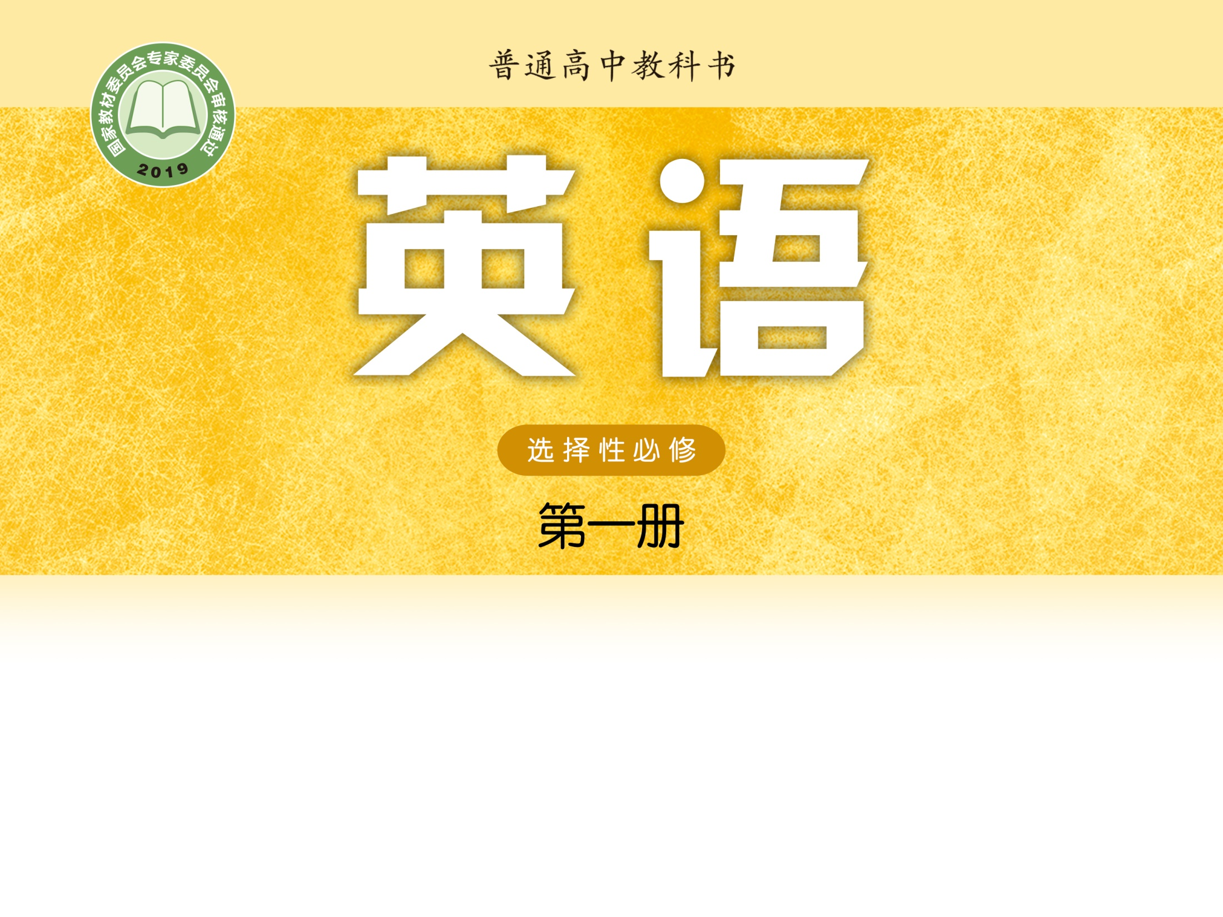
Unit 2 The universal language
Reading (II)
张林丽 江苏省通州高级中学

Slide 2

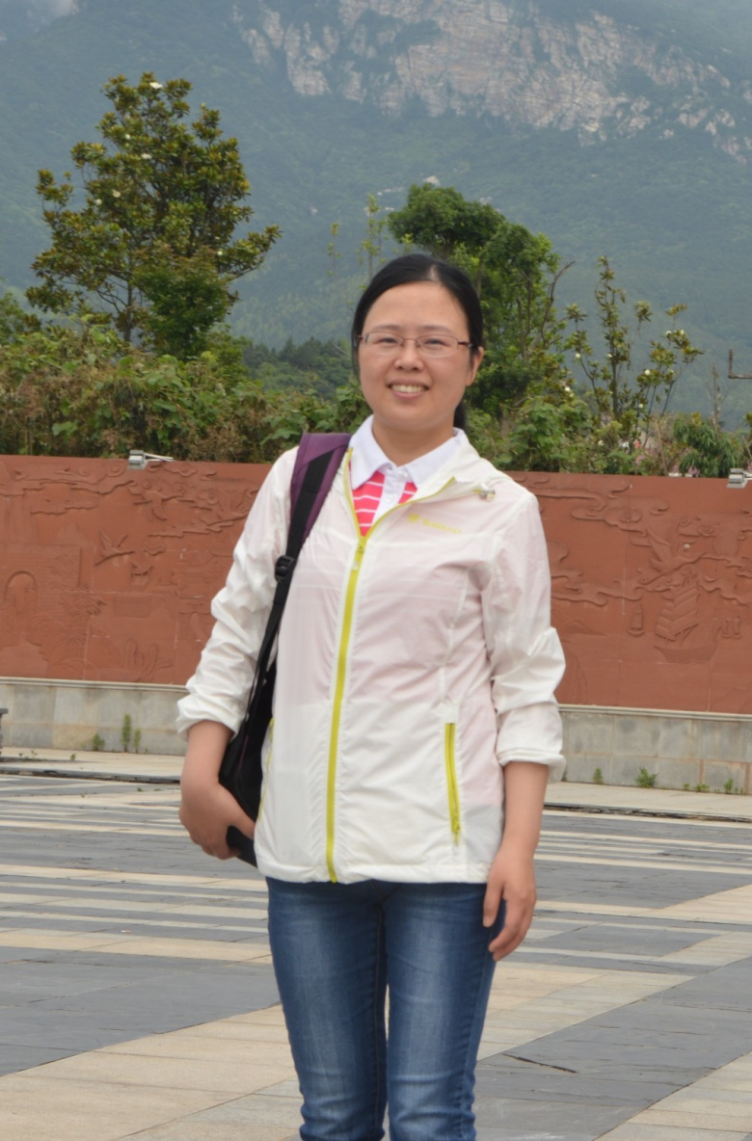
张林丽
中学一级教师
南通市青年教师基本功比赛二等奖

Slide 3
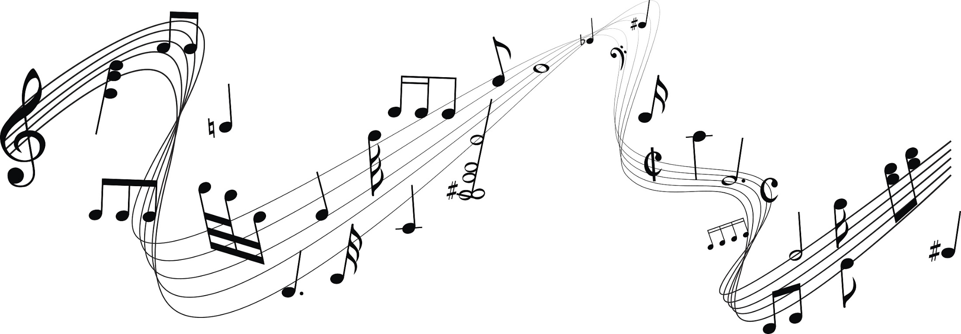
The universal language

Slide 4
The plot | Characteristics of the music | Atmosphere created by the music
The two lovers first meet.
 |  | happy
Liang falls sick and dies. Zhu weeps bitterly and jumps into Liang’s grave.
 |  | exciting
light and pleasant
as if whispering to the audience
The two lovers spend three years at school together.
fast and cheerful
The lovers are separated because ...
dramatic with heavier notes
angry and sad
The couple transform into butterflies and fly away to be together forever.
taking a softer turn and ending on a bittersweet note

Slide 5
Country music
History | The typical instrument(s) | Examples | Characteristics
born out of blues and folk music became popular: time: ____________ place: ____________________________ | _________ | The musician: _________ The song: ____________________________________ | tunes: _________ lyrics: ____________________ themes: hardship, heartbreak and hope
easy to sing
the guitar
John Denver
deep in thought
“Take Me Home, Country Roads”
in the 1940s
in the south of America

Slide 6
1. Last night, I watched a performance of Butterfly Lovers, a beautiful violin concerto composed by He Zhanhao and Chen Gang. (para. 1, lines 1–3)
昨晚，我观看了一场《梁祝》的演出，这是由何占豪、陈钢创作的一部动听的小提琴协奏曲。
compose v. to write music
Practice
莫扎特在创作出他最后一部歌剧后不久便去世了。
Mozart composed his last opera shortly before he died.

Slide 7
write … usually with a lot of care and thought
compose a letter/ speech/poem
Practice
他写了一封抗议信。
He composed a letter of protest.
composed
I like classical music, particularly music __________ by Mozart, Beethoven and other great __________. My favorite piece of music is Beethoven’s Symphony No. 9, one of his finest ___________.
composers
compositions

Slide 8
2. It’s a piece that really deserves to be heard. (para. 1, lines 4–5)
这部作品真的值得一听。
If somebody or something deserves something, it is right that they should have it, because of the way they have behaved or because of what they are.
Practice
• 这个建议应该给予认真考虑。
• 设计师所做的工作特别值得一提。
• 这本英文小说值得反复阅读。
This suggestion deserves careful consideration.
The work of the designers deserves a special mention.
This English novel deserves to be read again and again.
This English novel deserves reading again and again.

Slide 9
3. The music took me through the twists and turns of a classic story about a young couple torn apart by their families. (para. 2, lines 6–7)
乐曲带我进入了一个跌宕起伏的经典故事，讲述的是一对年轻情侣被他们家庭拆散的遭遇。
tear apart, tear at, tear … away from, tear down, tear … between … and …, tear … into pieces
• 我在父母和朋友之间左右为难。
I was ____________ my parents ______ my friend.
• 战争正在把这个国家搞得四分五裂。
War is ____________________________.
• 他只凭两只手就要把肉撕碎。
He __________ the meat with his bare hands.
torn between
and
tearing the country apart
tore at

Slide 10
tear apart, tear at, tear … away from, tear down, tear … between … and …, tear … into pieces
这本书是如此吸引人以至于我手不释卷。
This book is so attractive that I can’t __________________ from it.
悲愤之下，他将信撕成碎片。
Sad and angry, he _________________________.
这幢旧楼将要被拆除来为新图书馆腾出地方。
The old building will ___________ to make room for the new library.
tear myself away
tore the letter into pieces
be torn down

Slide 11
4. Then the music gets dramatic with heavier notes and that is when the lovers are separated because Zhu’s father forces her to marry another man. (para. 2, lines 10–12)
接下来，曲调突然变得沉重，此时这对情侣被拆散，因为祝英台的父亲逼她另嫁他人。
dramatic adj. (of a change, an event, etc.) sudden, very great and often surprising

Slide 12
Practice
• A dramatic increase/fall/change/improvement
• dramatic results/ developments/news
• a local dramatic society
• 听了那场励志演讲以后，他对生活的态度有了极大的改变。
暴涨/暴跌/巨变/巨大的改进
出人意料的结果/突飞猛进的发展/令人吃惊的消息
地方戏剧协会
After listening to the inspiring speech, his attitude toward life changed dramatically.

Slide 13
5. Overcome with sorrow, she jumps into his grave.
(para. 2, lines 13–14)
不胜伤悲，她跳进了梁山伯的坟墓。
[usually passive] to be extremely strongly affected by sth
①
Her parents were overcome with grief at the funeral.
在葬礼上她的父母悲痛欲绝。
②
She overcame injury to win the Olympic gold medal.
to succeed in dealing with or controlling a problem
③
In the final game Sweden easily overcame France.
to defeat sb

Slide 14
Practice
• 他在好奇心的驱使下打开了盒子。
___________________, he opened the box.
• 我发现很难克服考前的恐惧与紧张。
I find it hard to ___________________________before an exam.
• 感到恐惧与紧张，我发现考前睡不好觉。
_____________________________, I find it hard to have a sound sleep before an exam.
Overcome with curiosity
overcome my fear and nervousness
Overcome with fear and nervousness

Slide 15
6. Butterfly Lovers combines Chinese and Western musical elements: it is played on Western instruments such as the violin, but more significantly, much of the music has its roots in Chinese Yue Opera. (para. 3, lines 18–20)
《梁祝》融合了中西方的音乐元素：以西方乐器，譬如小提琴等演奏，但更重要的是，其曲调大多源自中国的越剧。
Butterfly Lovers ________ Chinese and Western musical elements: it is played on Western instruments such as the violin, but more significantly, much of the music has its roots in Chinese Yue Opera.
mixes

Slide 16
Practice
• 这家旅馆既舒适又方便。
The hotel __________ comfort _______ convenience.
• 把锻炼和健康饮食结合起来是安全减肥的一种方式。
_________________________________ is a safe way to lose weight.
• 只有通过多方努力我们才能有效解决这个难题。
________________________ can we effectively solve the tough problem.
• 这种独特的交融使我认识到，音乐的确是一种世界语言。
This unique ____________ has made me realize that music is indeed a universal language.
combines
with
Combining exercise with a healthy diet
Only with combined efforts
combination

Slide 17
7. The tunes are easy to sing, and the lyrics often leave you in deep thought. Most of the songs are about hardship and heartbreak, but also about hope—with plenty of humour thrown in for good measure. (para. 2, lines 9–12)
乡村音乐的调子朗朗上口，歌词常常发人深省。大部分歌曲唱的是艰难与心碎，但也有希望——其中还附加了很多幽默元素。
throw … in
to include sth with what you are selling or offering, without
increasing the price
for good measure
as an extra amount of something in addition to what has already been done or given

Slide 18
Practice
• 我们花了8,000元买了这台电脑，打印机是附送的。
We paid 8,000 yuan for the computer, with a printer ________.
• 您付4,000元就能买走这部手机，另外我还送您这副耳机。
You can have the mobile phone for 4,000 yuan and I’ll __________ the earpiece.
• 他以便宜的价格把房子卖给了我，外加一个小花园。
He sold me the house at a low price, including a small garden ________________.
thrown in
throw in
for good measure

Slide 19
8. Why don’t you try to listen to some great country music? I guarantee you’ll enjoy it! (para. 4, lines 24–25)
你为什么不试试几首很棒的乡村音乐？我保证你会喜欢的！
Practice
• 仅有丰富的资源不能确保经济发展。
Rich resources alone do not ________________________.
guarantee economic growth
• 我们保证一周内交货。
We _________________________ within a week.
guarantee to deliver your goods

Slide 20
Practice
• 我们不能保证我们的所有航班均不误点。
We cannot guarantee (that)________________________
___________.
• 现在，包括言论自由在内的基本人权已有了保障。
Basic human rights, including freedom of speech, __________________.
• 他向我保证这种事情绝不会再发生。
He gave me __________that it would never happen again.
• 这块手表仍在保修期内。
This watch is still ______________.
• 事业成功绝非幸福的保证。
Career success is __________________ happiness.
our flights will never be
delayed
are now guaranteed
a guarantee
under guarantee
no guarantee of

Slide 21
combine overcome transform rely on
deserve pleasant guarantee for good measure
transform
Music has the power to (1) ____________ our lives. To give the public more access to music, we will put on a series of free concerts. Music in different styles, from classical to jazz, will be played. You can (2) __________ us to show you some of the world’s best-known works. The first of these concerts will be held in front of the arch in the downtown square at eight next Friday evening. Come and spend a __________ evening with us!
rely on
pleasant

Slide 22
At the concert you will enjoy the Yellow River Piano Concerto, one of China’s greatest contributions to classical music. Like the violin concerto Butterfly Lovers, this piano concerto also (4) ___________ Chinese and Western musical elements and is well received across the world. The musical piece, an adaptation of Xian Xinghai’s Yellow River Cantata, tells how the Chinese people, led by the Communist Party of China, fought to (5) __________ the Japanese invaders. It consists of four movements: “The Song of the Yellow River Boatmen”, “Ode to the Yellow River”, “The Yellow River in Anger” and “Defend the Yellow River”. The difficult piano solo in particular (6) ___________ a mention. The concert will end with some short pieces of violin music (7) _________________. We (8) ___________ that you will enjoy this concert!
combines
overcome
deserves
for good measure
guarantee

Slide 23
Questions
Q1: What’s the similarity between Yellow River Piano Concerto and the violin concerto Butterfly Lovers?
Q2: What does Yellow River Piano Concerto tell us?

Slide 24
Possible answer
Q1: They both combine Chinese and Western musical elements and are well received across the world.
Q2: It tells us how we Chinese people, led by the Communist Party of China, fought to overcome the Japanese invaders.

Slide 25
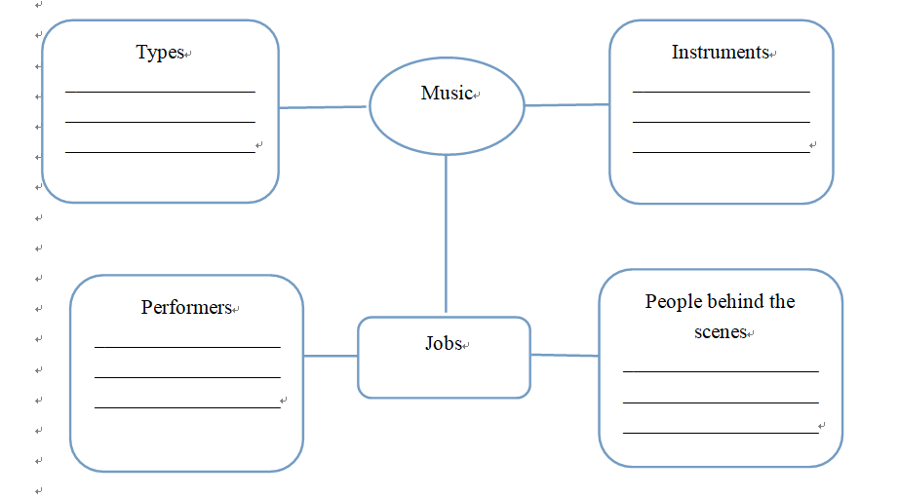
B2
The emails use some music-related vocabulary. Find the words in the emails and think of more on your own. Complete the chart with as many music-related words as you can.
opera, country, the blues, folk, classical, jazz, pop
violin, guitar, piano, cello, erhu
conductor,singer,
pianist, violinist
composer, songwriter

Slide 26
B3
With personification, a thing is described like a human being. This way, the description becomes more vivid and interesting, enabling the reader to look at the thing in a new and different way.
Alice uses personification when she describes the violin concerto Butterfly Lovers. Find the sentence and describe your favorite piece of music using personification.

Slide 27
The sentence using personification
When the two lovers, Liang Shanbo and Zhu Yingtai, first meet, the music is light and pleasant, as if whispering to the audience.

Slide 28
A sample
My favorite piece of music is the one by the jazz musician George Benson called White Rabbit. The trumpet announces the piece loudly and confidently. It is followed by the gentle sounds of the electric guitar which get more energetic as they compete for your attention. As the piece progresses, all the instruments finally join hands and dance together in perfect harmony.

Slide 29
Homework
Polish up the writing in pairs after class.

Slide 30


