Slide 1

Unit 2 The universal language
Extended reading
徐淑芬 江苏省通州高级中学

Slide 2


徐淑芬
中学高级教师
南通市通州区十佳高三教师
南通市通州区优课评比一等奖

Slide 3
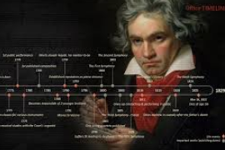
Lead-in
QUIZ
music genius
born in Germany
?
every orchestra plays his works
composer & pianist
suffer from loss of hearing

Slide 4

Beethoven:
a remarkable life

Slide 5
Global reading
Main idea of each paragraph
Para. 1
The first-ever performance
of Symphony No. 9
Para. 4
Introduction to Symphony No. 9
Para. 2
Beethoven’s life journey before his late twenties
Para. 5
Para. 3
Beethoven’s reputation and achievements
Beethoven’s attitudes in
the face of the loss of
hearing

Slide 6
Analyzing the structure
Part 1
(Para. 1)
Highlight
Early life
& adversity
Part 2
(Para. 2–3)
Part 3
(Para. 4)
Music
Part 4
(Para. 5)
Life finale

Slide 7
Close reading
Para. 1
Audience
Beethoven
unaware of the
audience’s response
until one turned him
around
· broke into enthusiastic cheers
· standing, clapping, waving
their hats and handkerchiefs
astonished
admired
moved
respectful
calm
content
comfortable

Slide 8
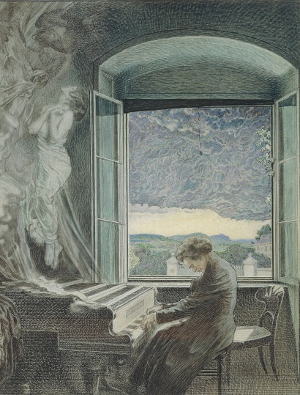
Para. 2
Group
discussion
· Was Beethoven regarded as a promising musician only by his talent?
· What helped Beethoven build up a
reputation as a wonderful young
musician?

Slide 9
Para. 3
（1）What did Beethoven do to overcome the loss of hearing in paragraph 3?
seek for different ways to continue composing music
share with his brother in secret
return to stage with Symphony No. 9
reduce performances

Slide 10
（2）What personality did Beethoven show during his struggle against the fate?
optimism
diligence
persistence
dedication
fearlessness
...

Slide 11
Para. 4
1 Since that day, Beethoven’s Symphony No. 9 has become one of the most famous and treasured pieces in the history of classical music. 2 The first movement starts quietly, but all of a sudden the whole orchestra breaks into an energetic theme. 3 You can soon feel the determination—a quality Beethoven understood well because of his hearing difficulties— coursing through the music. 4 The next two movements are full of desperate lows and uplifting highs which perhaps reflect both his suffering and his strong will to fight it. 5 The music moves through technically difficult sections with ease, showing his genius as a composer. 6 Finally, in the fourth movement, he connects all of the different variations into a joyful chorus.
S1
TS
S2
SS1
S3
DS1
S4
SS2
S5
DS2
S6
SS3

Slide 12
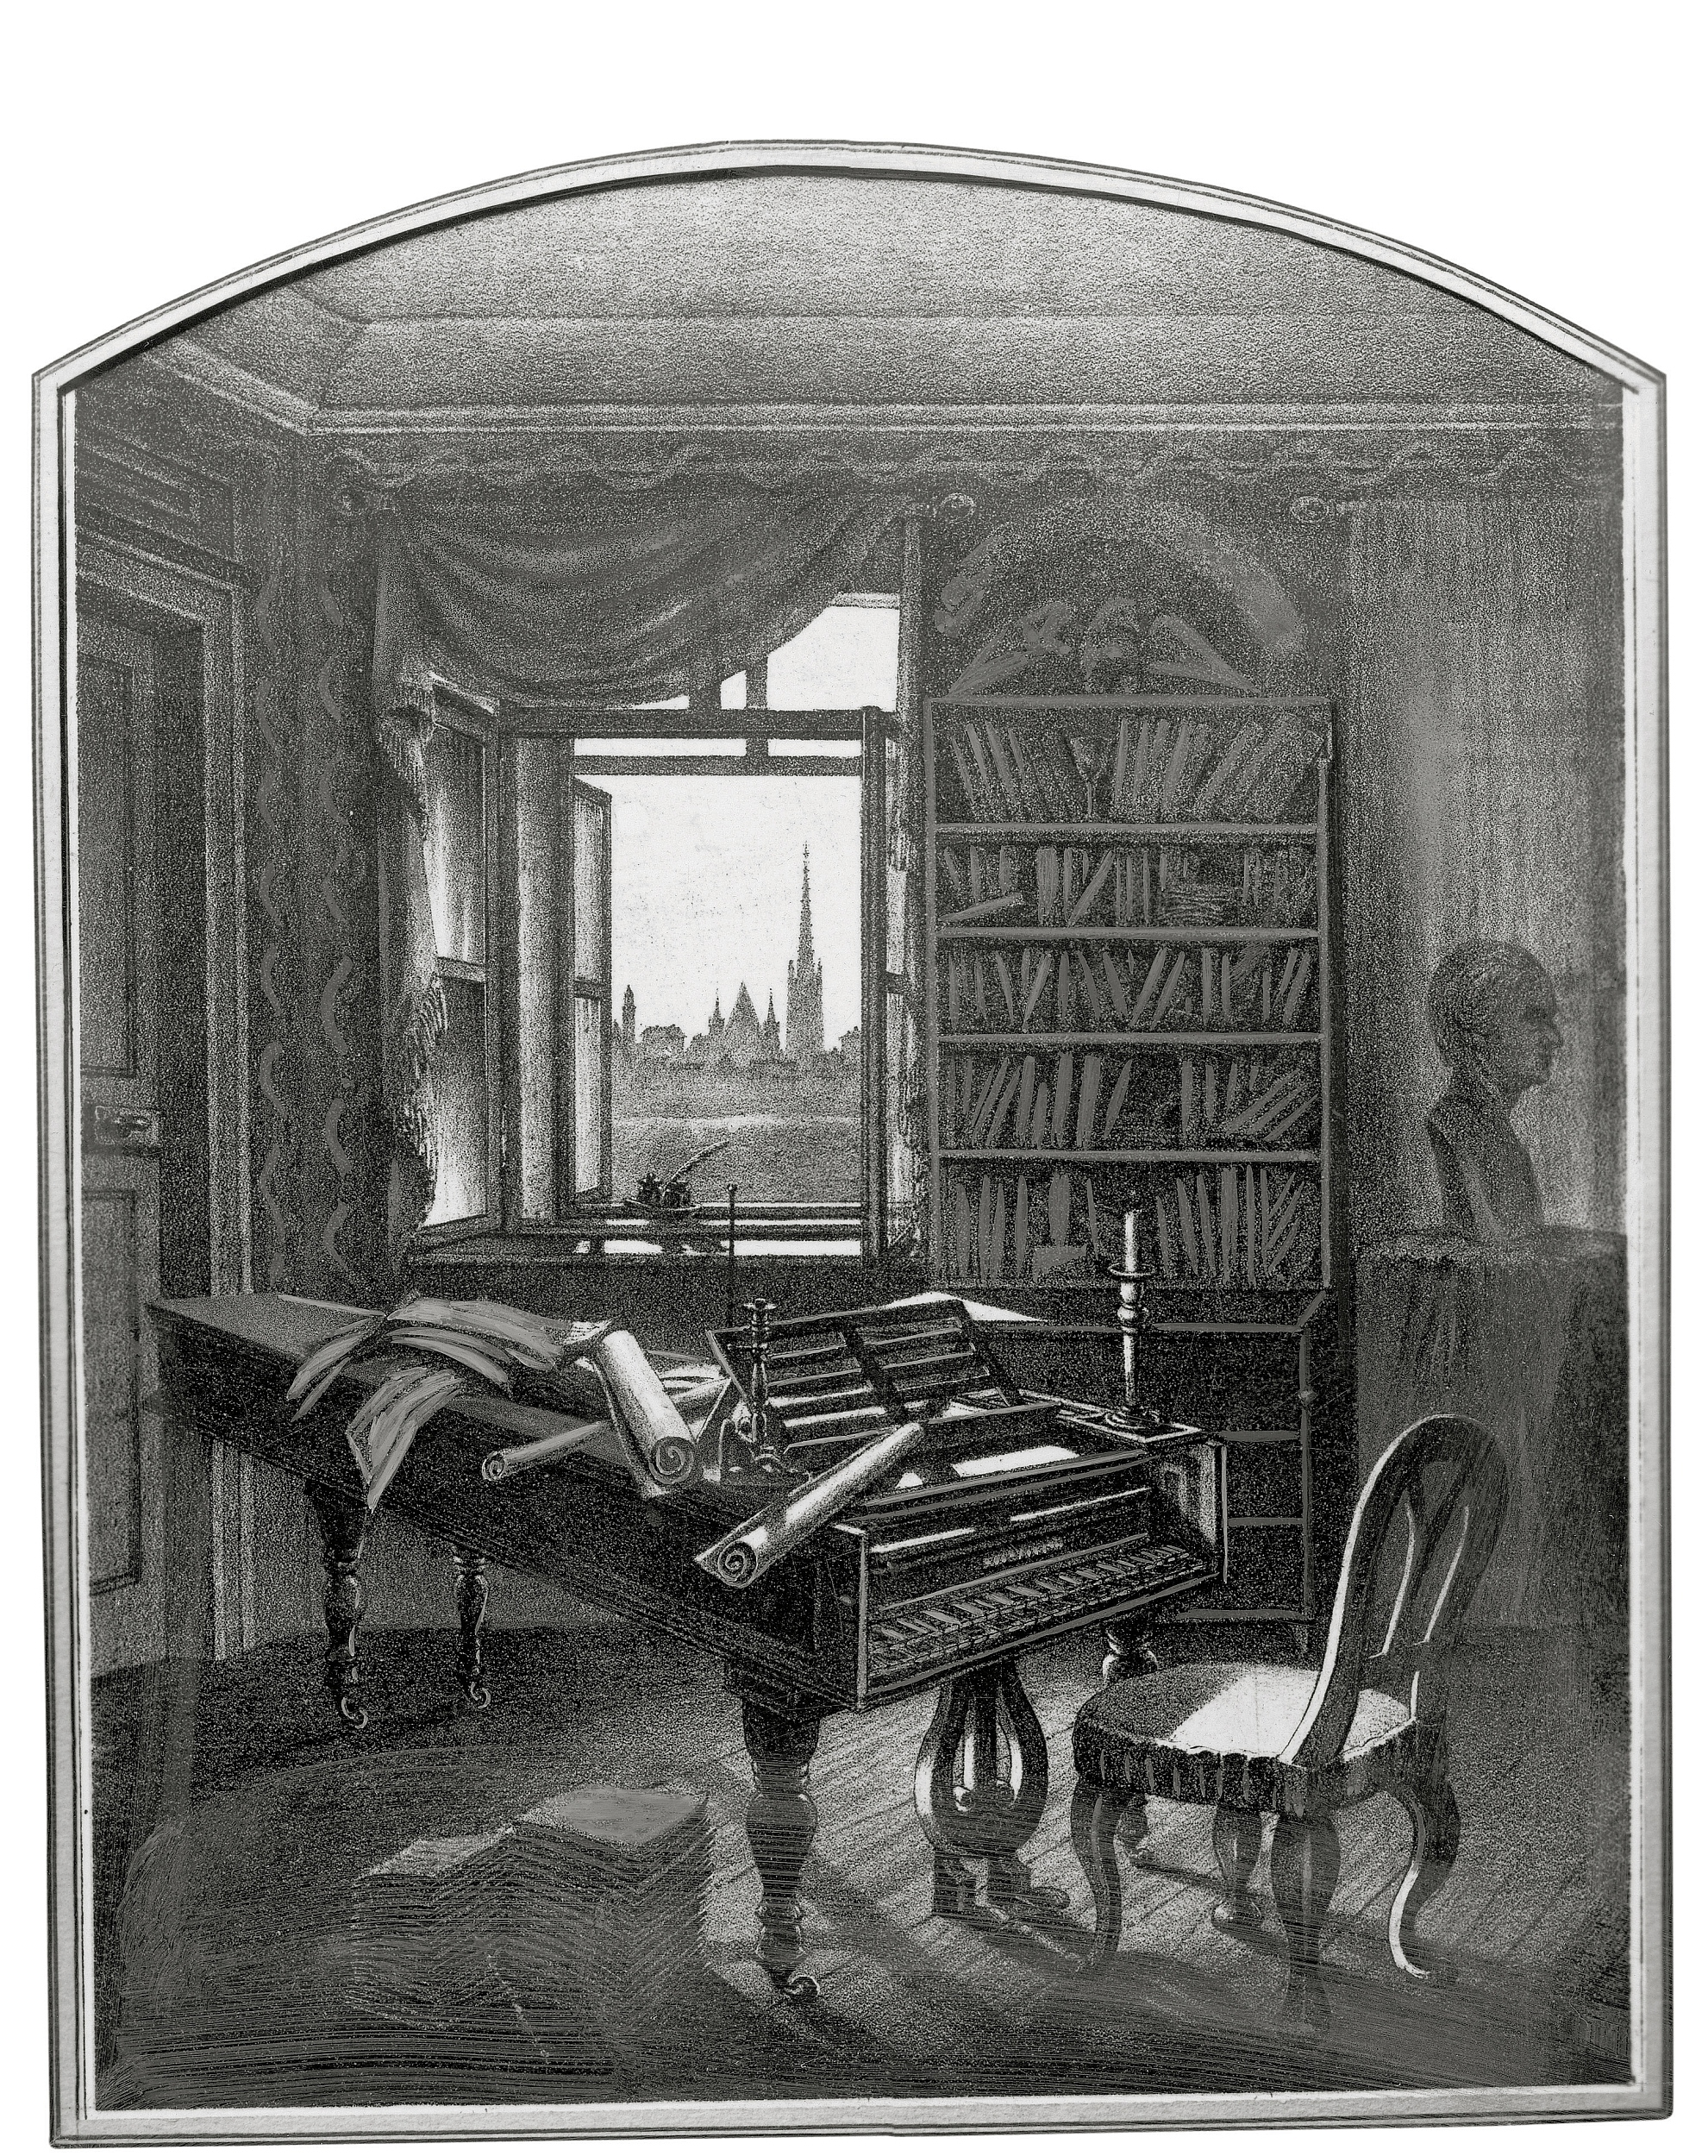
Para. 5
Why is Beethoven regarded as one of the most remarkable musicians in history?

Slide 13

Critical thinking
The string of the passage
On 7 May 1824, a crowd of music lovers streamed into a theatre in Vienna to hear ... Beethoven’s Symphony No. 9 (Para. 1)
Symphony No. 9
Since that day, Beethoven’s Symphony No. 9 has become one of the most famous and treasured pieces ... (Para. 4)
Symphony No. 9 was Beethoven’s last major piece of music in ... (Para. 2)
As Beethoven’s last great work, his Symphony No. 9 was also a grand finale to his life ... (Para. 5)
When Beethoven presented Symphony No. 9 in Vienna in 1824, it was his first time ... (Para. 3)

Slide 14
Why does the author choose
Symphony No. 9 as the string of the whole passage?
①
⑤
②
④
③
Symphony No. 9

Slide 15

●Symphony No.9 is regarded as Beethoven’s greatest work. “Ode to Joy” is sung during the final movement of the symphony. Beethoven is the musician who lost hearing but brought joy to the world.
●The desperate lows and uplifting highs of the symphony perfectly indicate twists and turns of the musician’s life.

Slide 16
Appreciation
Flashback
Para. 1
Para. 2
Para. 3
Para. 4
Para. 5
Highlight
Life and work
To arouse interest
To create twists
To avoid stereotype
...

Slide 17


Homework
1. Suppose your friend Li Lei is suffering from depression and feeling ashamed of his terrible condition. Use what you’ve learned from the story of Beethoven and write a letter to comfort him.
2. Explore the Internet and find more about Beethoven and his works.

Slide 18
One possible version
Dear Li Lei,
Thank you for your trust. I’m sorry to hear about your current situation. Actually, life can be tough sometimes, and anybody can hardly avoid stress and negative feelings, including you and me.
I’d like to share with you a story of Beethoven I recently read. As a musician, he suffered from the loss of hearing most of his life. At the beginning, he found it hard to admit his problem and kept it a secret. But later, he wrote to his brother and sought for effective ways to live a life full of music. With great determination during the darkest time, he composed the well-known symphonies, such as No. 5 “Fate”, and No. 9 “Ode to Joy”. I strongly recommend you to listen to his symphonies, in which you can feel twists and turns of life and perseverance of the musician.
If you’d like to have a chat, don’t hesitate to contact me. Hope you’ll feel better and we’ll appreciate Beethoven’s symphonies together.
Yours faithfully
Li Hua

Slide 19


