Slide 1

Unit 2 The universal language
Integrated skills (I)
殷春霞 江苏省通州高级中学

Slide 2

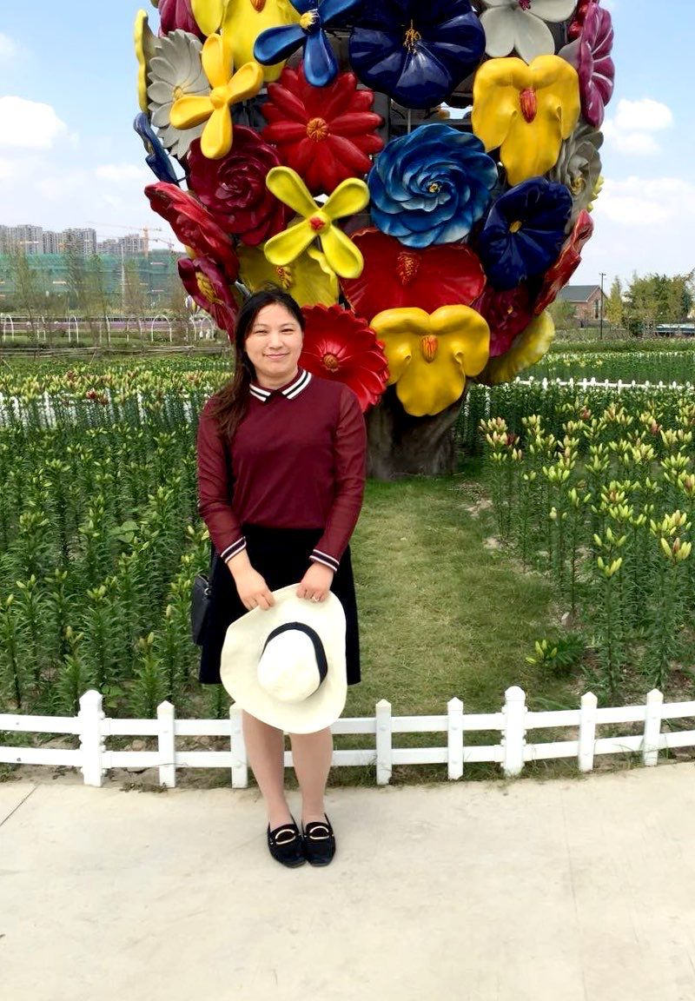
殷春霞
南通市优质课评比一等奖
南通市高中英语骨干教师
通州区高三优秀教师
通州区教学“六认真”先进个人

Slide 3
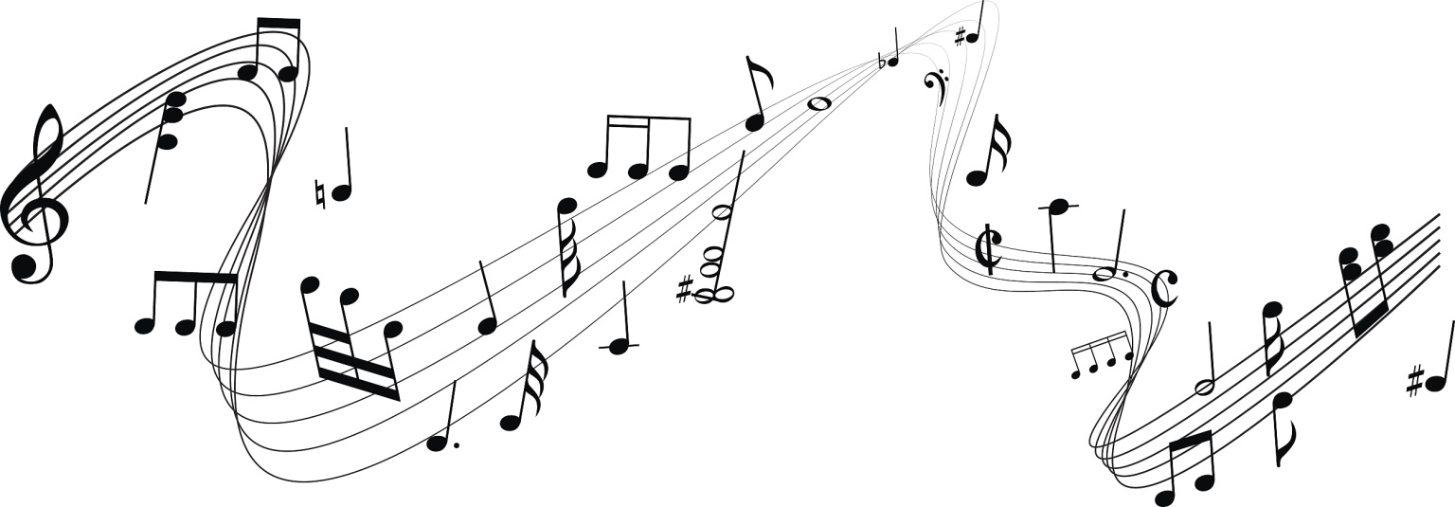
Lead-in
1. Who is your favorite singer or band?
2. What are your favourite songs by the singer or band?
3. What are the features of your favourite singer’s or band’s music?

Slide 4
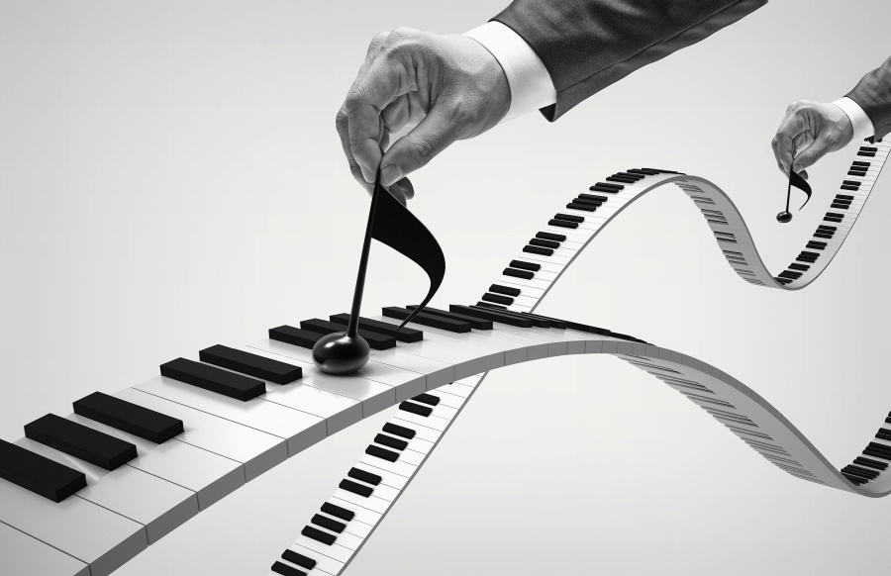
Listen and decide whether the statements are true or false.
1. Hot Hits and Super Sounds is being broadcast for the first time. T / F
2. The programme lasts for an hour every day. T / F
3. Listeners can choose songs to be played for their friends. T / F
4. Listeners’ stories will be shared on the radio every other week. T / F
Friday
month

Slide 5

Why does the radio programme bring students the first broadcast of the brand new show?
To help the students take a break from their busy studies and relax themselves in the world of music.

Slide 6
Listen and complete the notes
Hot hits and Super Sounds
When is the programme?
At 12 noon every (1)_____________
What is broadcast?
(2) _____________ as well as old catchy tunes
Different types of music, from the blues to jazz, from pop
to (3) _____________
Stories about (4) ______________________
How can listeners take part?
Let the host know what they want to hear by getting in touch on (5) _________________
Share their personal musical journey and be invited to be (6) _____________
Friday
Modern hits
rock and roll
singers, bands and their music
Just give us a shout on the school forum, …
the school forum
guest DJ

Slide 7
Explain the title
What does the title mean?
The “Fab Four” stands for the Beatles, which had four members.

Slide 8

Introduction
What do you know about the Beatles?

Slide 9
The Beatles is the most famous British rock band of the 20th century. It was originally formed in 1959, and finally founded in 1962, Liverpool. In 1970, due to the difference of opinions, the Beatles announced their breakup. Before their breakup , the band had issued more than 20 albums.
Brief introduction:
John Lennon
Ringo Starr
Paul McCartney
George Harrison
Members:

Slide 10
Love Me Do
Abbey Road
Yesterday
Help
Hey Jude
Let It Be
Yellow Submarine
…
Songs:
Is there a song by the Beatles that impresses you most?

Slide 11

Read and learn about the structure
The Fab Four
Paras. 1–2: The writer’s love for the Beatles
Para. 3: A simple intruduction to the Beatles and their popularity
Para. 4: The writer’s star-struck journey with the Beatles and the Beatle’s influence on him

Slide 12
Appreciation of the language
Para. 1:
I rushed down the stairs as fast as I could to get nearer to the radio.
I turned up the volume and stood staring at the radio, holding my breath and waiting for the first notes of the song.
Emotions:
eager to listen to the song
interested in the song

Slide 13
Appreciation of the language
Para. 2:
When the song had finished, I stood not knowing whether I liked it or not.
… I couldn’t wait to hear this song again and again until it became my favourite song from my favourite band.
Emotions:
confused about the different sound
fascinated by the song

Slide 14
Appreciation of the language
Para. 4:
I can picture my bedroom decorated with posters of the Fab Four smiling down at me and I can see myself riding my bicycle through country lanes singing “yeah, yeah, yeah” at the top of my voice.
Emotions:
fond of music

Slide 15

The feature of the language
The author expresses his love for the Beatle’s music by using ______ words.
action

Slide 16
Homework
Search more information about the Beatles.

Slide 17


