Slide 1
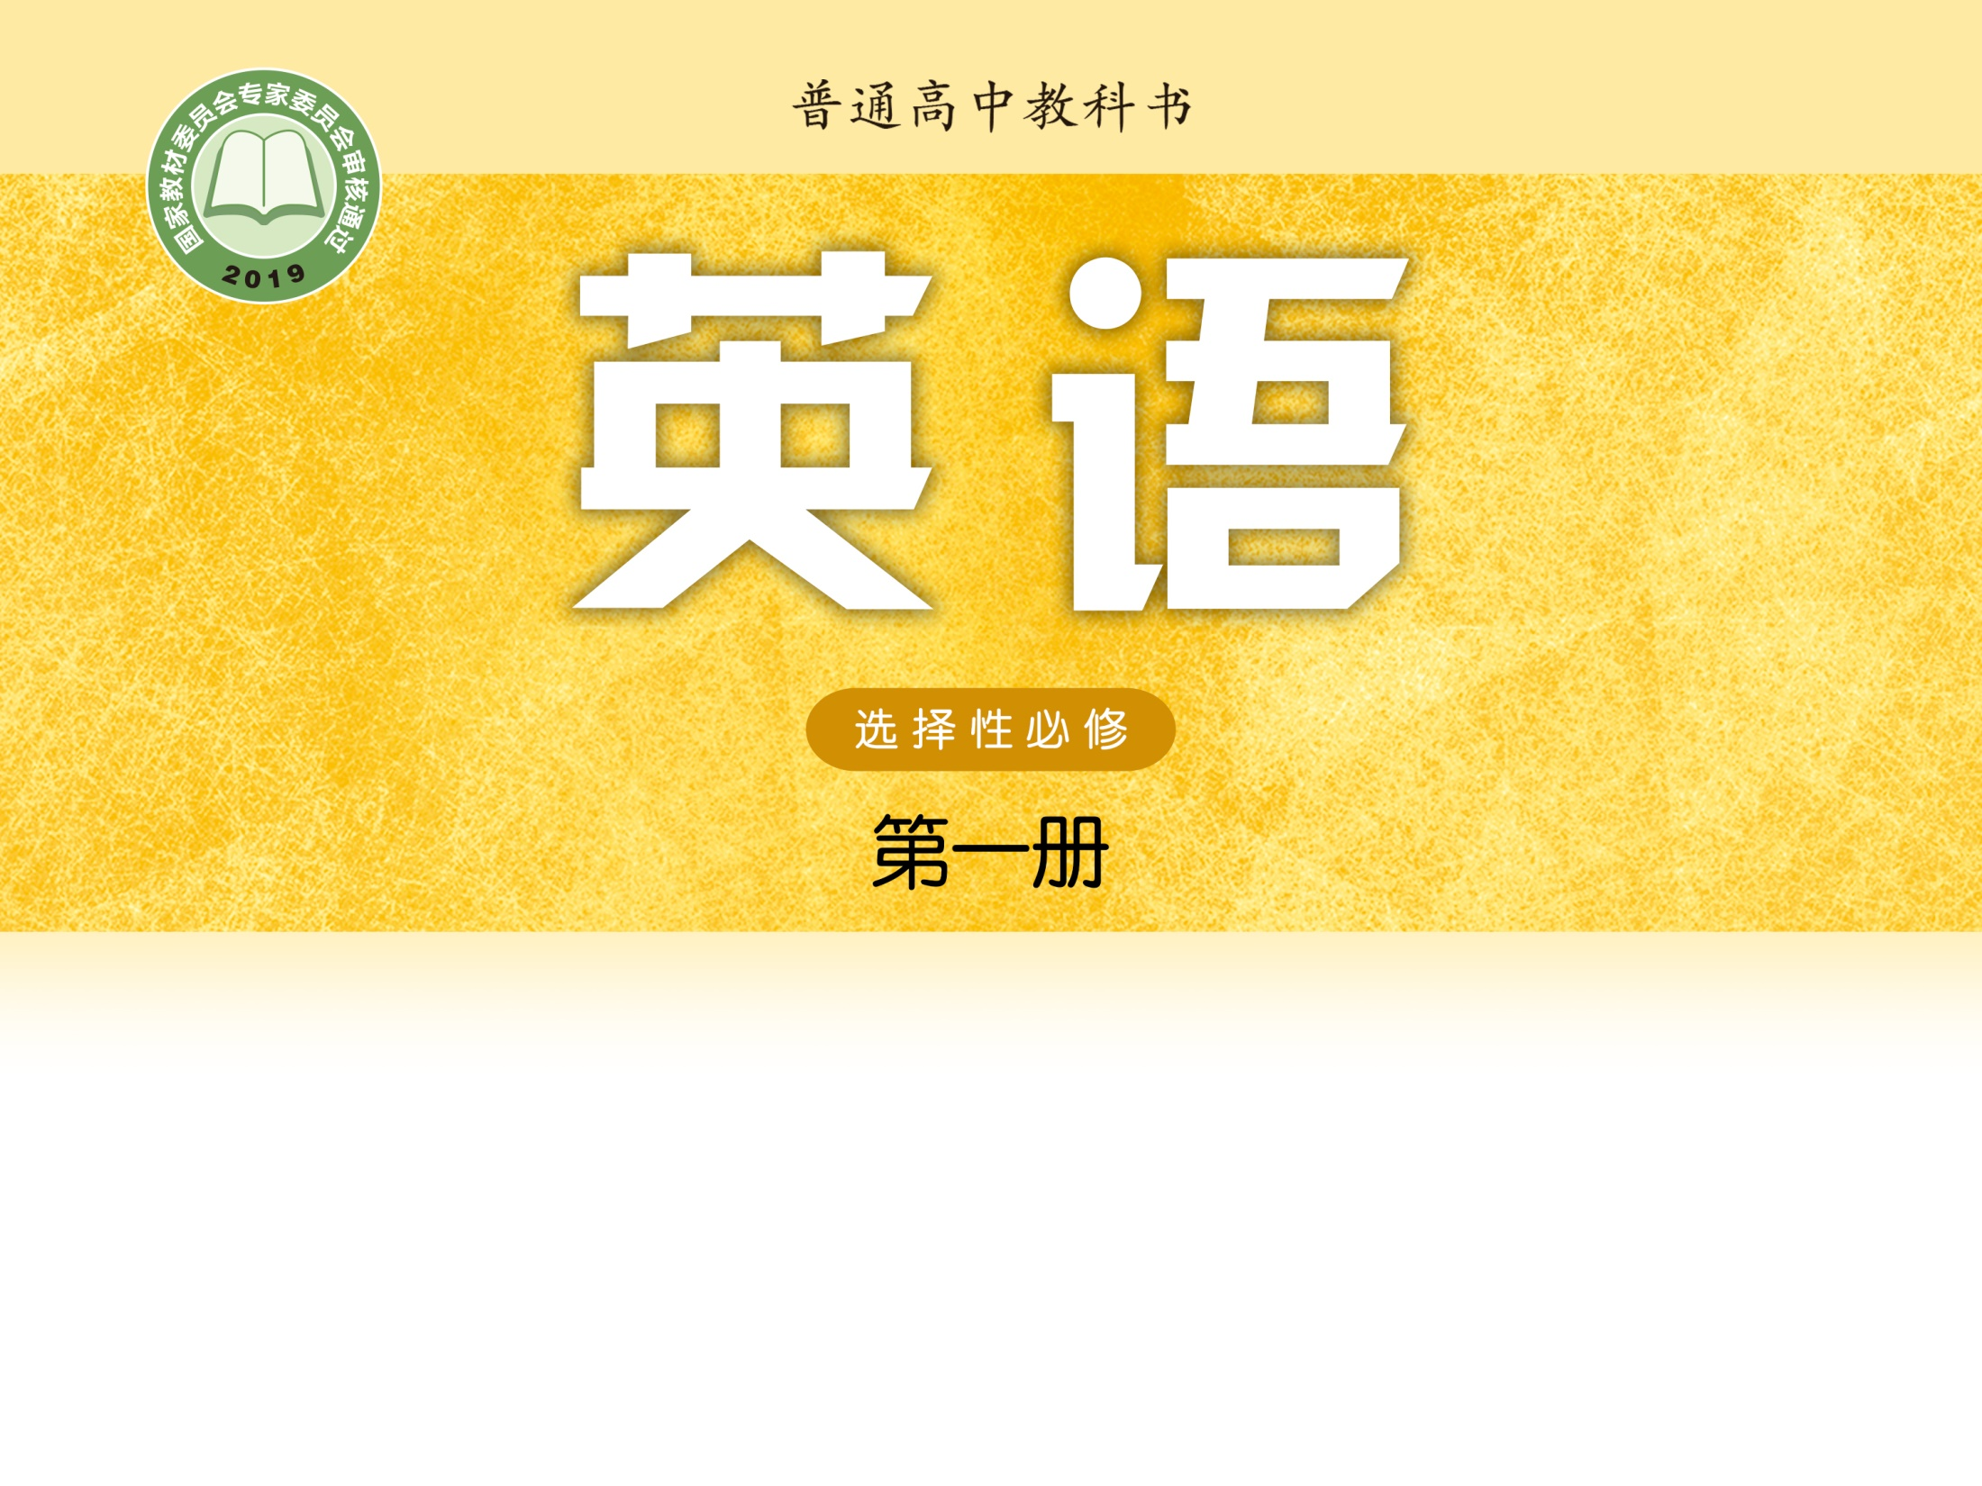
Unit 1 Food matters
Grammar and usage
龙薇 株洲市第二中学

Slide 2
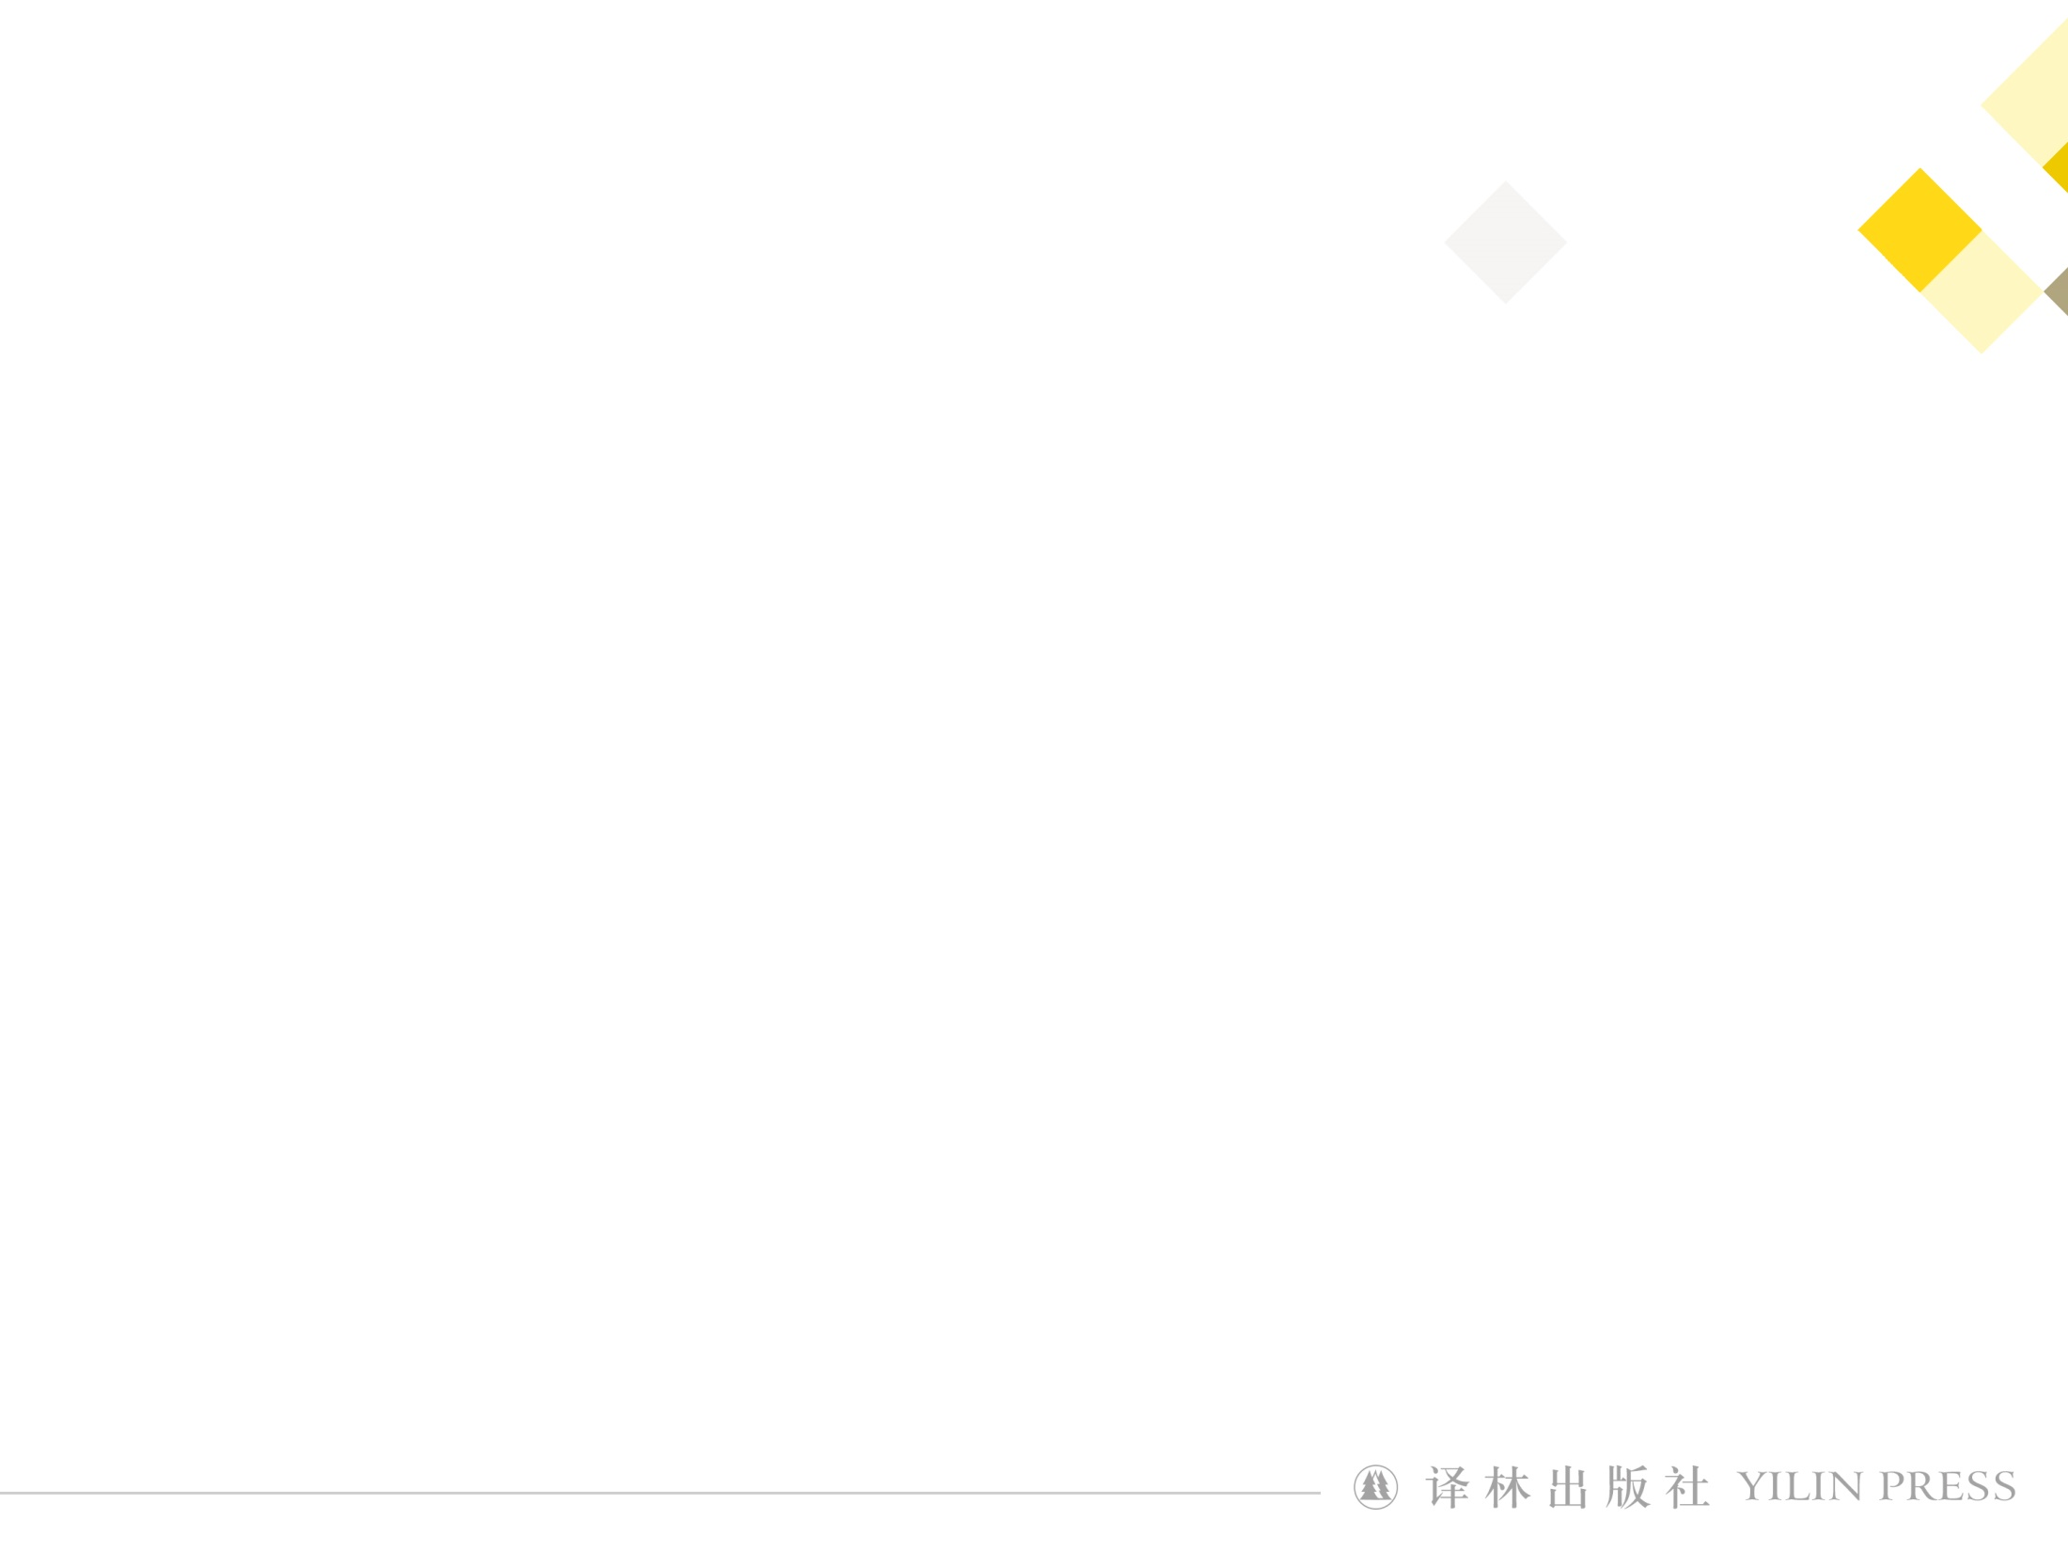
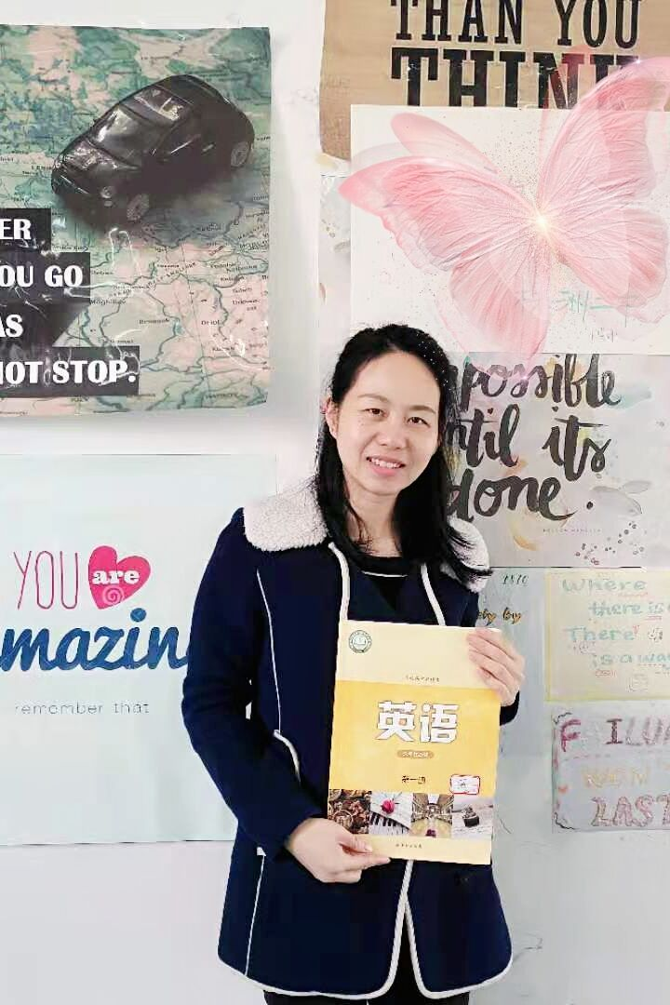
龙薇
中学一级教师
株洲市英语创新课堂一等奖
株洲市一师一优课一等奖

Slide 3
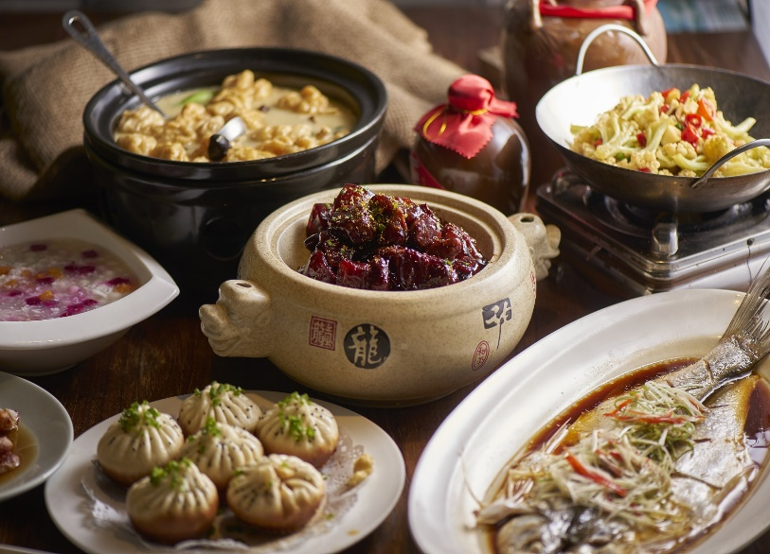
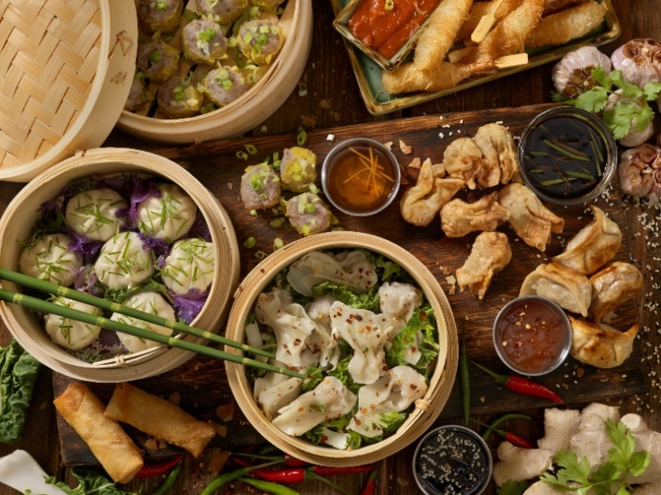
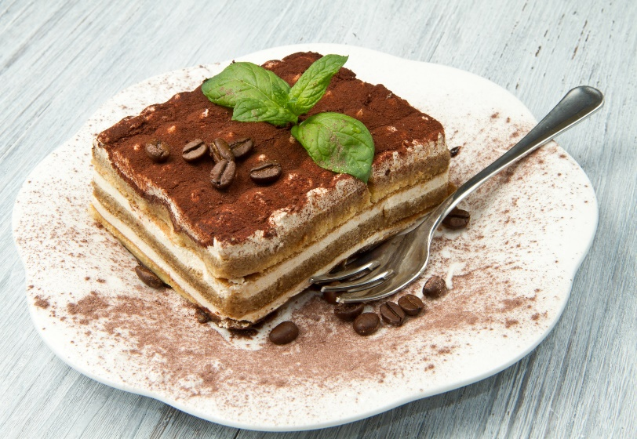
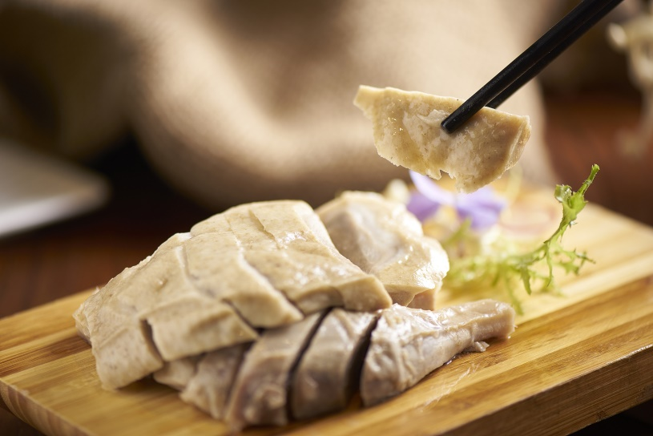

Slide 4
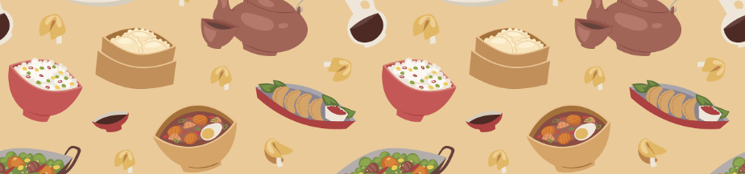
• As a real foodie, I enjoy all kinds of foods. My dream is to try different restaurants and taste various foods.
• Yesterday I invited some friends to try a great new restaurant for dinner.
• We arrived at the restaurant, only to see a huge line of people waiting to get into the restaurant.
• Nothing can stop our determination to have a try. We decided to wait outside.
• After an hour of waiting, we were invited to go into the restaurant and take the order.
• The dishes are extremely delicious. It is worthwhile to have such a long wait.

Slide 5
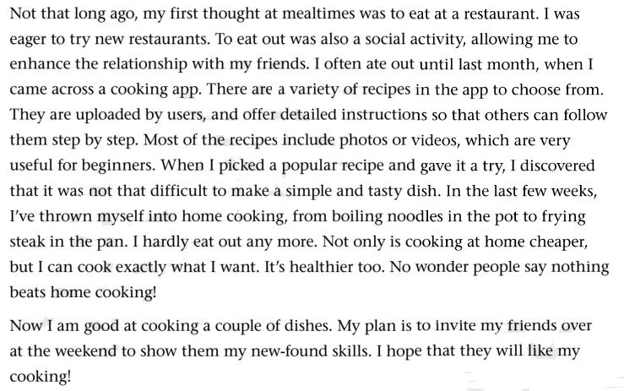
Exploring the rules
Below is a blog entry about eating out and eating at home. Find the sentences that use to-infinitives as subjects.

Slide 6
Exploring the rules
To-infinitives as subjects
To eat out was also a social activity, ...
..., it was not that difficult to make a simple and tasty dish.

Slide 7
Exploring the rules
To-infinitives as subjects
When the to-infinitive is used as a subject, we usually use the preparatory subject at the beginning of the sentence.
Working out the rule
it

Slide 8
Exploring the rules
Below is a blog entry about eating out and eating at home. Find the sentences that use to-infinitives as predicatives.

Slide 9
Exploring the rules
To-infinitives as predicatives
..., my first thought at mealtimes was to eat at a restaurant.
My plan is to invite my friends over at the weekend ...

Slide 10
Exploring the rules
To-infinitives as predicatives
The to-infinitive can also be used as a predicative. It usually comes after the verb .
Working out the rule
be

Slide 11
Practice
• 被邀请到你家做客真的是太荣幸了。
It is a great honour to your family.
• 在家做饭准备环节需要花很长时间。
It takes a long time home-cooked meals.
to be invited
to prepare for
It is + n.(a pity, a shame, an honour …) to do sth
It takes sb some time/money… to do sth

Slide 12
Practice
• 你为我们做了这么多美味的菜真的是太好了。
It is nice ____ you _______ so many tasty dishes for us.
• 在当今社会，我们学会做饭还是很有用的。
It is useful _____ us .
of
to make
for
to learn how to cook
It is + adj.+ for/of sb to do sth

Slide 13
Practice
• 然而，烹饪对于我来说还有点挑战性。
However, cooking seems challenging for me.
• 是否我能学会做几个菜，以后见分晓。
It remains ____________ if I can cook a couple of dishes.
to be
to be seen

Slide 14
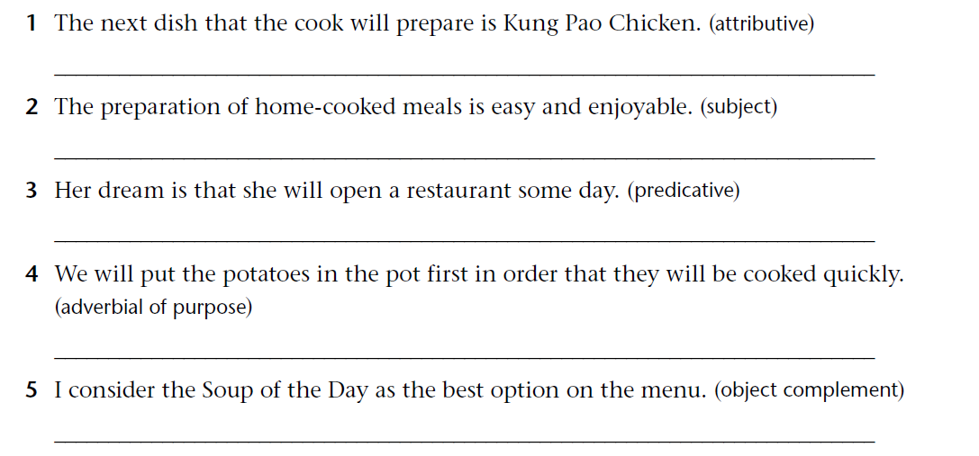
Applying the rules
  Rewrite the following sentences, using to-infinitives.

Slide 15
Answer
1. The next dish to be prepared by the cook is Kung Pao
Chicken.
2. To prepare home-cooked meals is easy and enjoyable./
It is easy and enjoyable to prepare home-cooked meals.
3. Her dream is to open a restaurant some day.
4. We will put the potatoes in the pot first (in order) to cook
them quickly.
5. I consider the Soup of the Day to be the best option on the
menu.

Slide 16
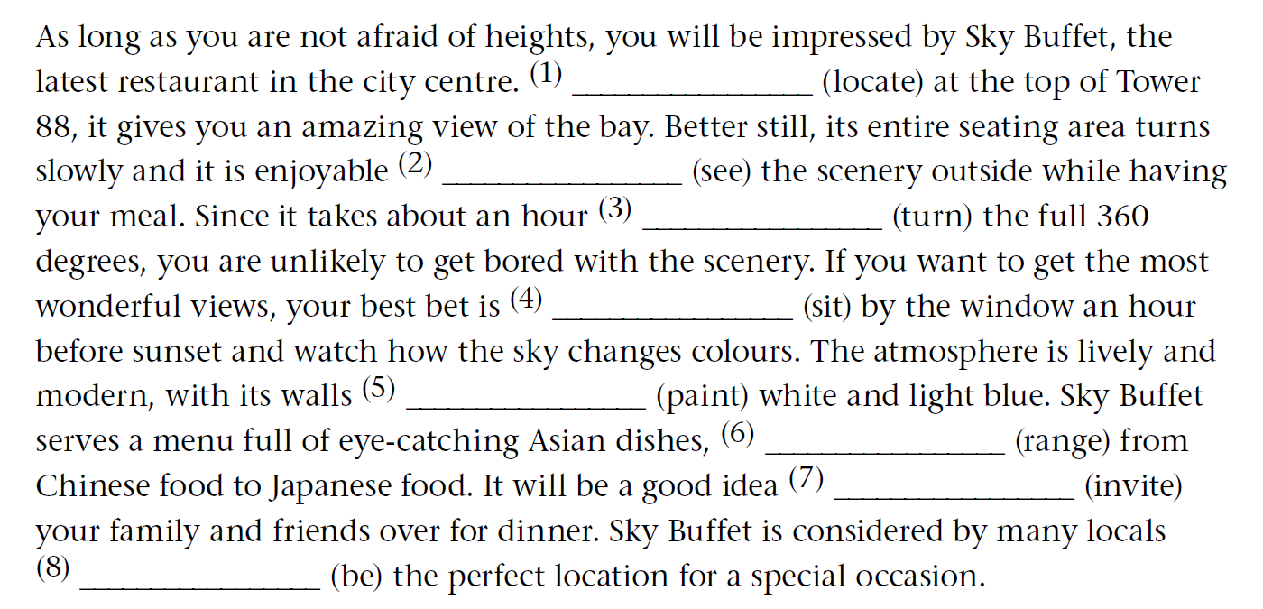
Applying the rules
  Complete the article with the correct forms of the verbs in the
  brackets.
Located
to see
to turn
to sit
painted
ranging
to invite
to be

Slide 17
Applying the rules
Imagine your friend has taken you out to dinner at Sky Buffet. Write a thank-you note to your friend, offering to return the favour by inviting him or her to your home for dinner next weekend. Remember to use to-infinitives. Use the expressions below to help you.
Expressions
I am writing to … | I have always wanted to …
It was so kind of you to … | I would like/love to …
It was wonderful to … My plan is to …

Slide 18
Presenting

Slide 19
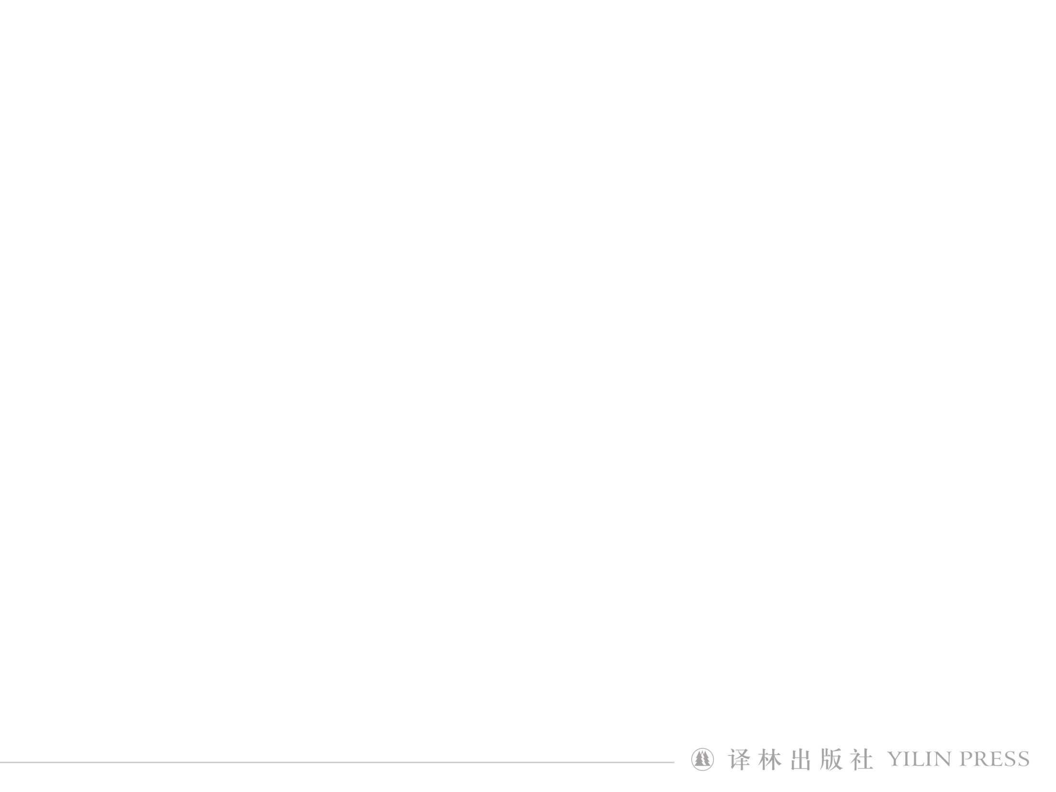
Homework
______________________________________________________________
Polish your writing after class.

Slide 20


